Slide 1
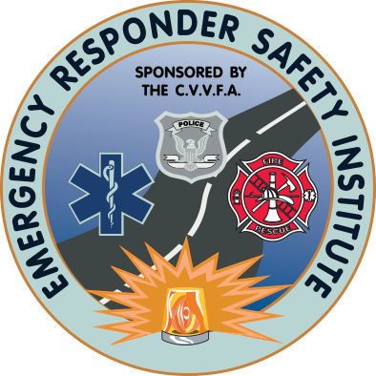


Traffic Incident Management at Wildfires:
TIM Practices for Safe, Efficient Operations
Funded By:
Notes:
These practices relate to wildland incidents and associated challenges of fire size, fire movement related to factors like topography and wind including sudden shifts in fire direction, evacuating residents, conflicting traffic movement (as responders move into areas residents are moving out of), smoke obscuration, and similar behavioral or fire/smoke movement situations.

Slide 2
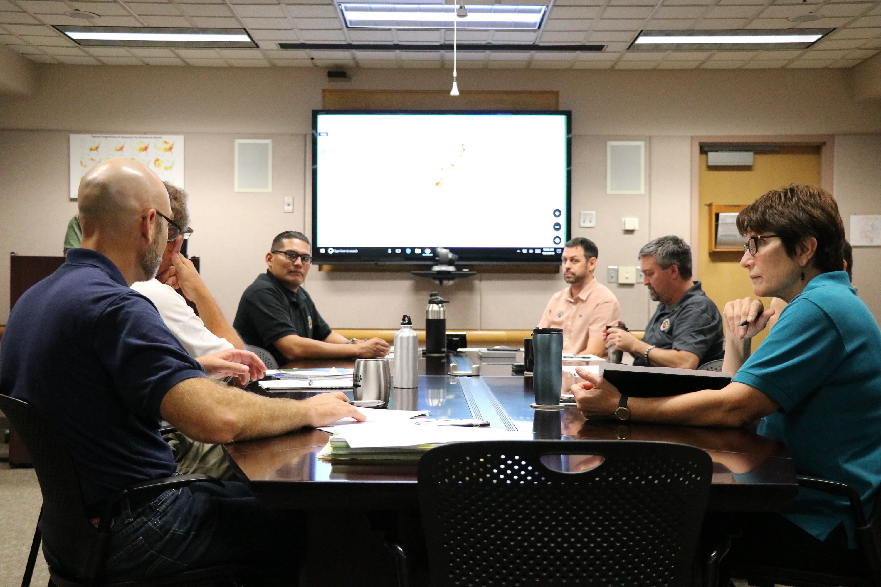
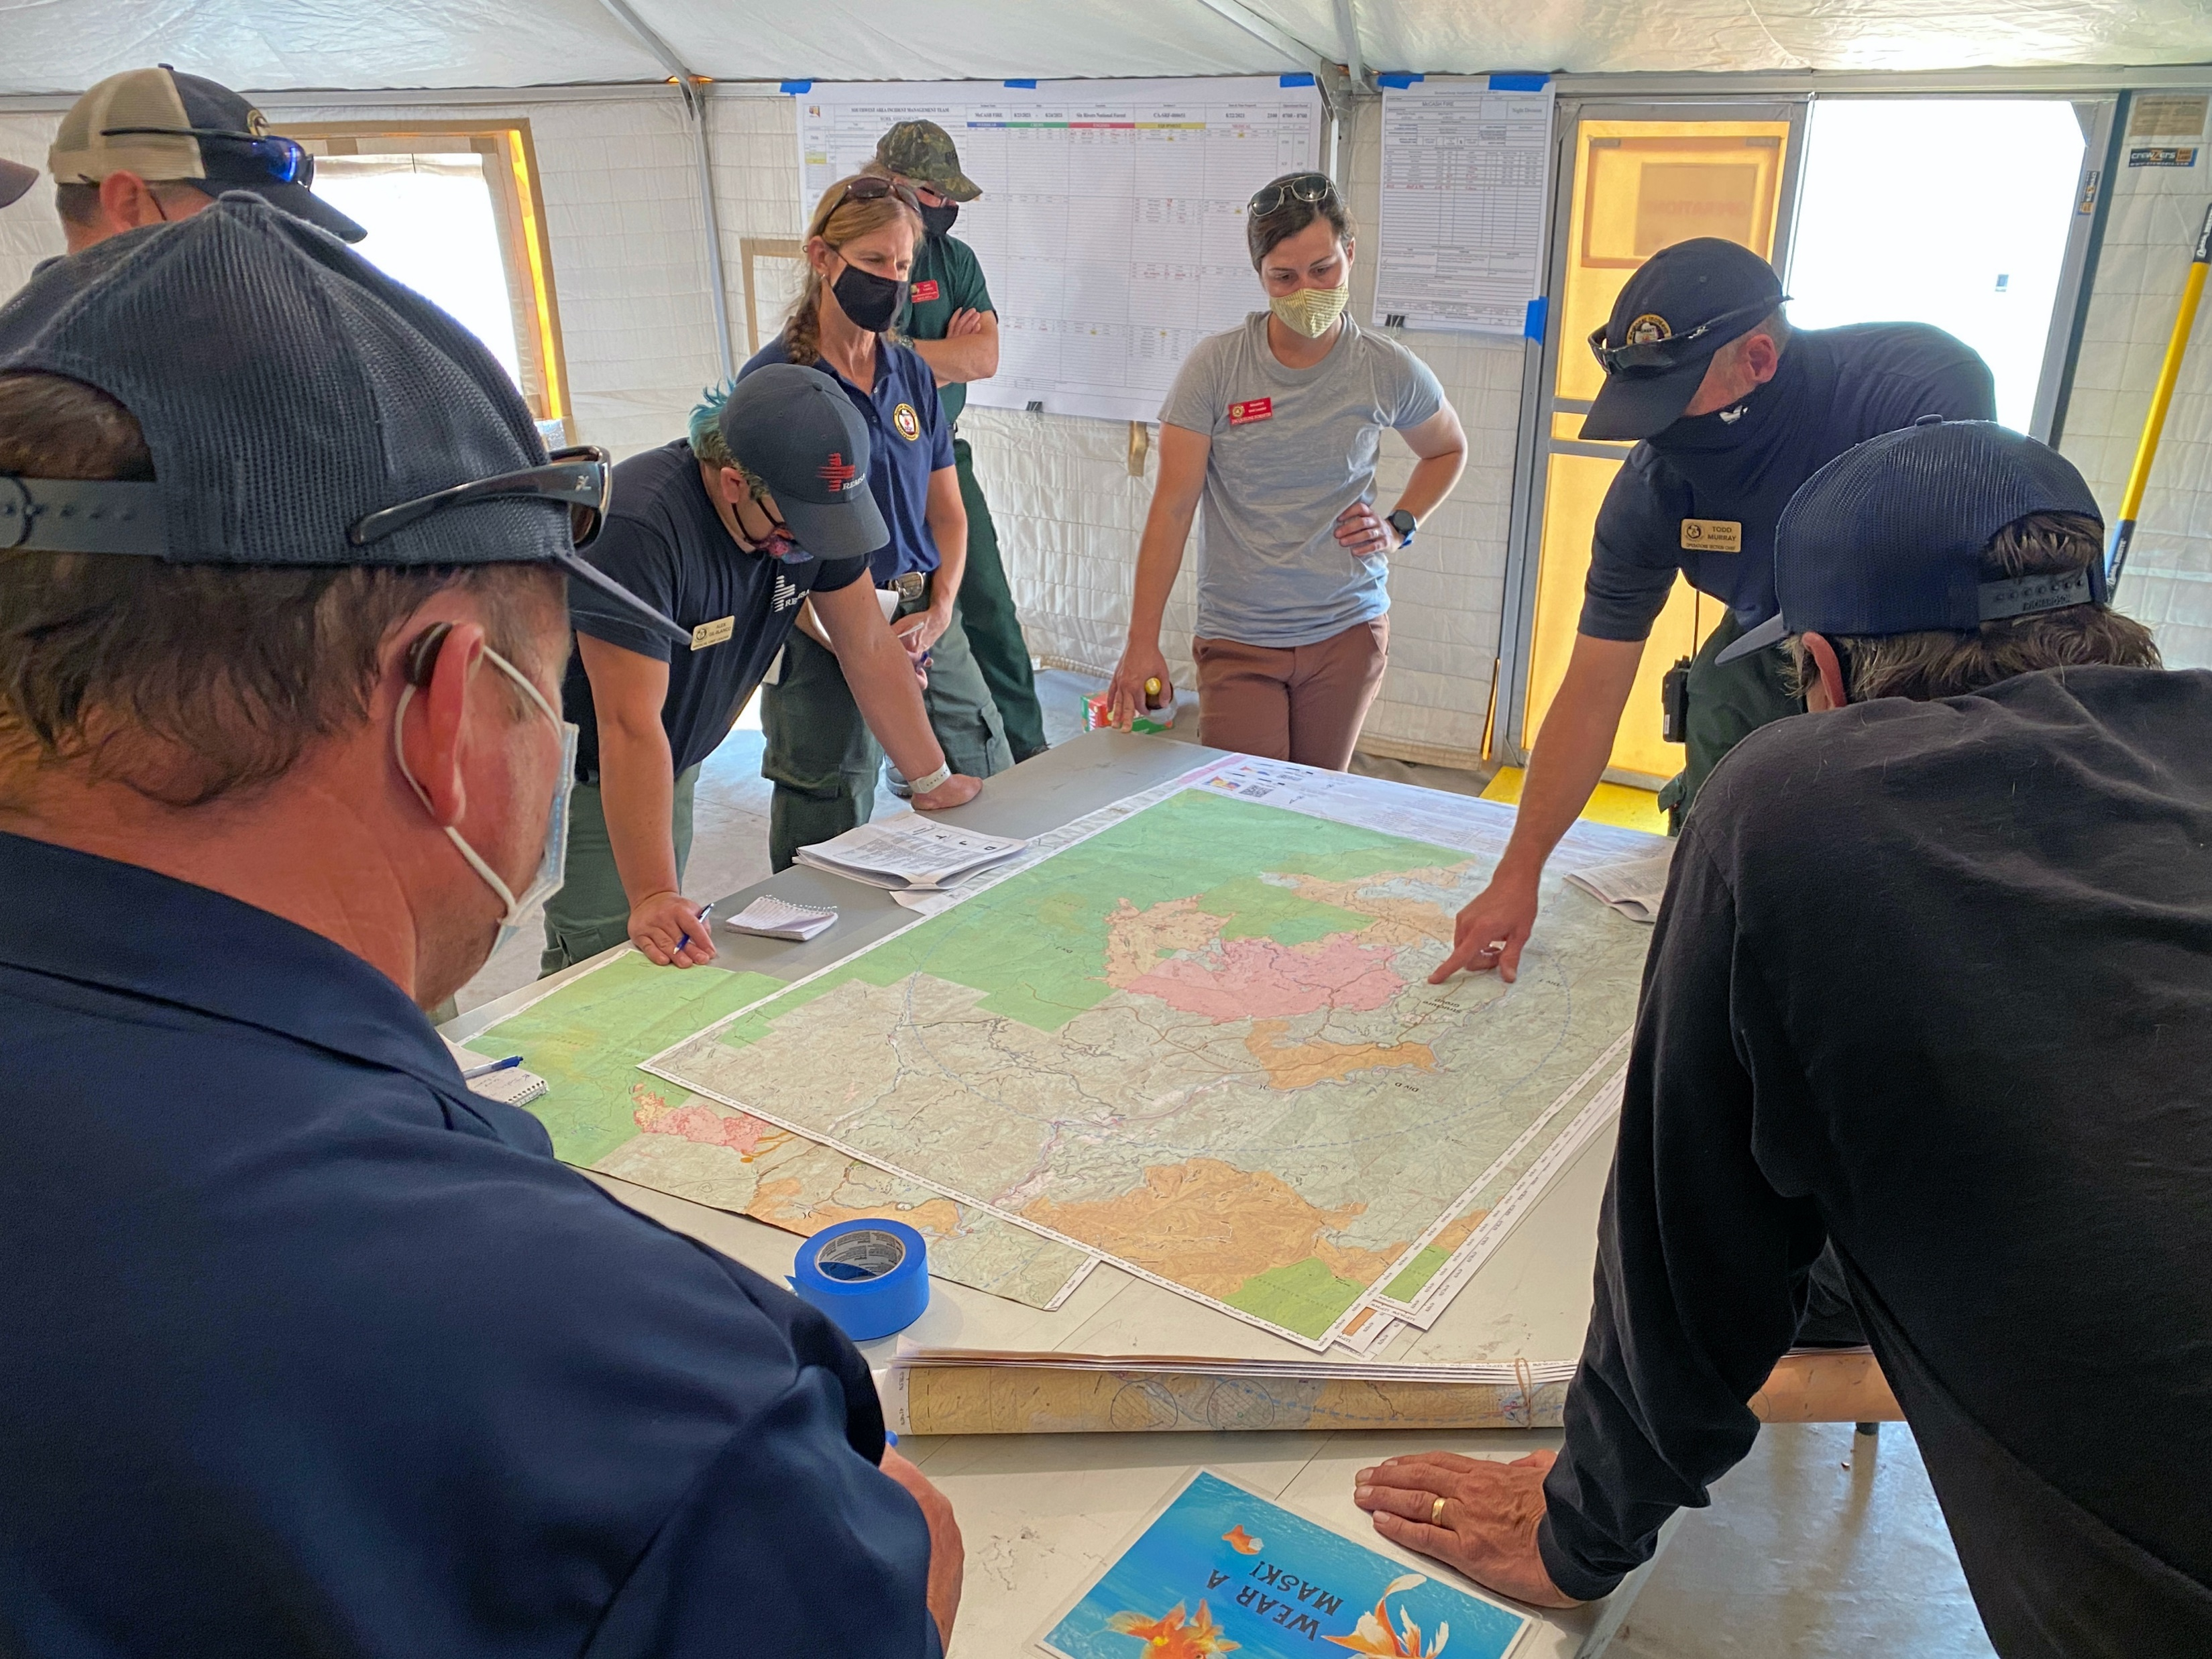
Pre-Planning
Photo credit: National Interagency Fire Center
Notes:
Key principles include:
Implement an inter-agency pre-planning entity, such as a Traffic Incident Management Committee, and process to coordinate, communicate, and collaborate on effective planning and response to wildfires.
Include traffic incident management in the incident response pre-planning process; integrate TIM at wildfires into SOPs, responsibilities, available resources, and procedures.
Plan for specific, known hazards and risks, including scenarios that would impact major roadways.
Conduct inter-agency training.
Hold after action reviews to debrief and analyze responses to previous incidents, glean lessons learned, and apply those lesson learned.

Slide 3
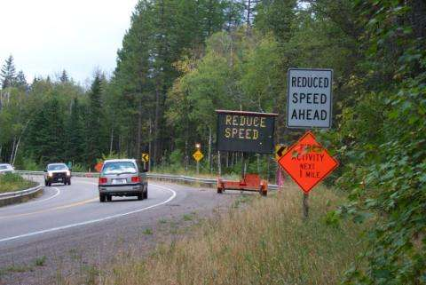
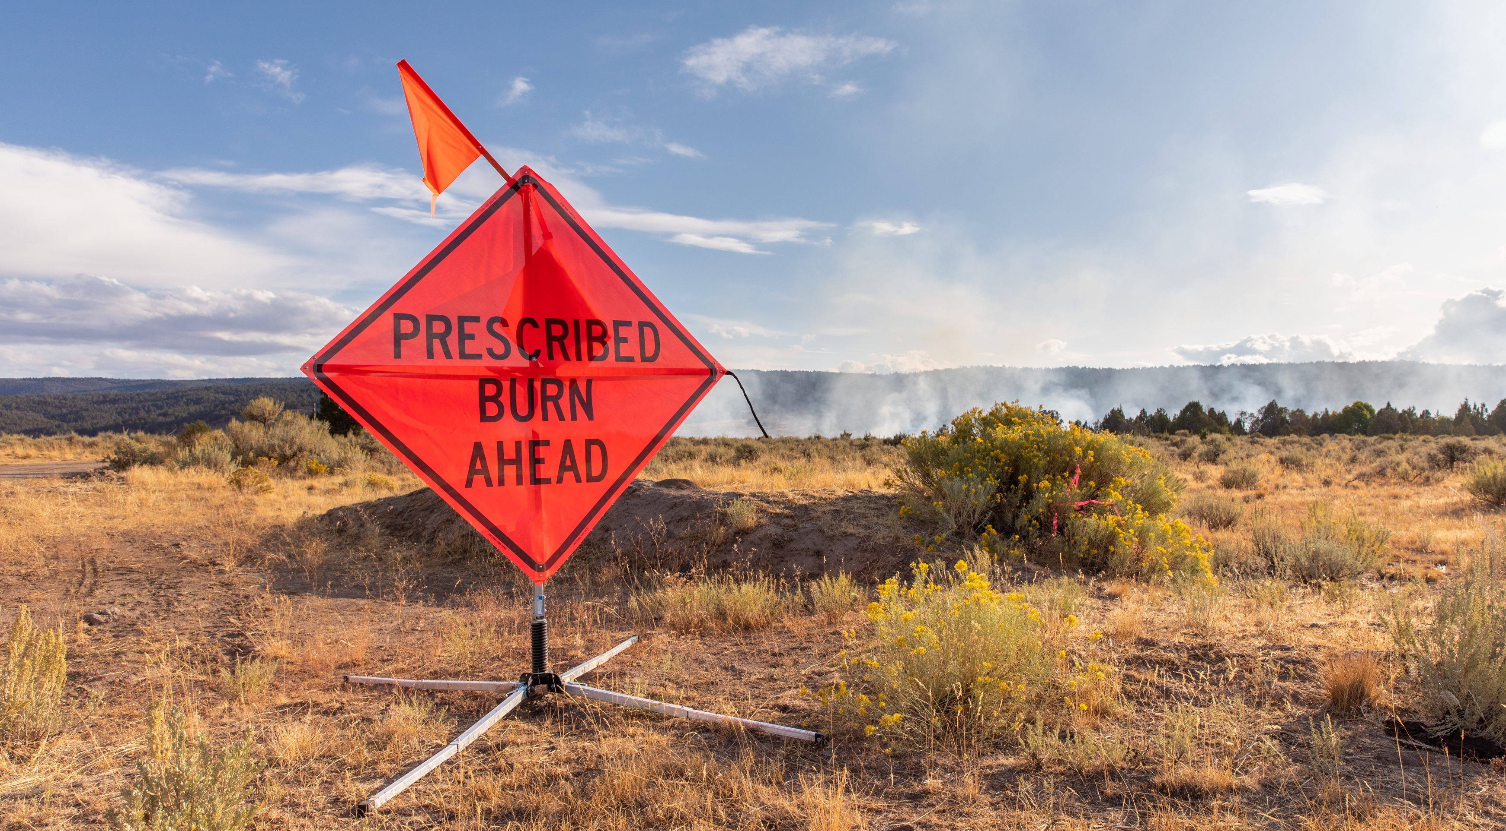
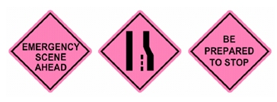
Advance Warning
FHWA Operations – Department of Transportation
Photo credit: National Interagency Fire Center
Photo credit: USFS
Notes:
Key principles include:
Give traffic plenty of warning: Use signs, cones, flares, flaggers, vehicles, and warning lights bring attention to the presence of emergency response.
Leave plenty of space between responders and moving traffic.
Traffic speed and volume as well as sight conditions dictate the distance and types of advance warning that are adequate.
Wildland apparatus are typically not equipped with signs or cones. Organizations may need to create resource lists to provide this equipment.

Slide 4
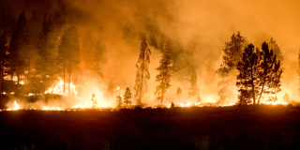
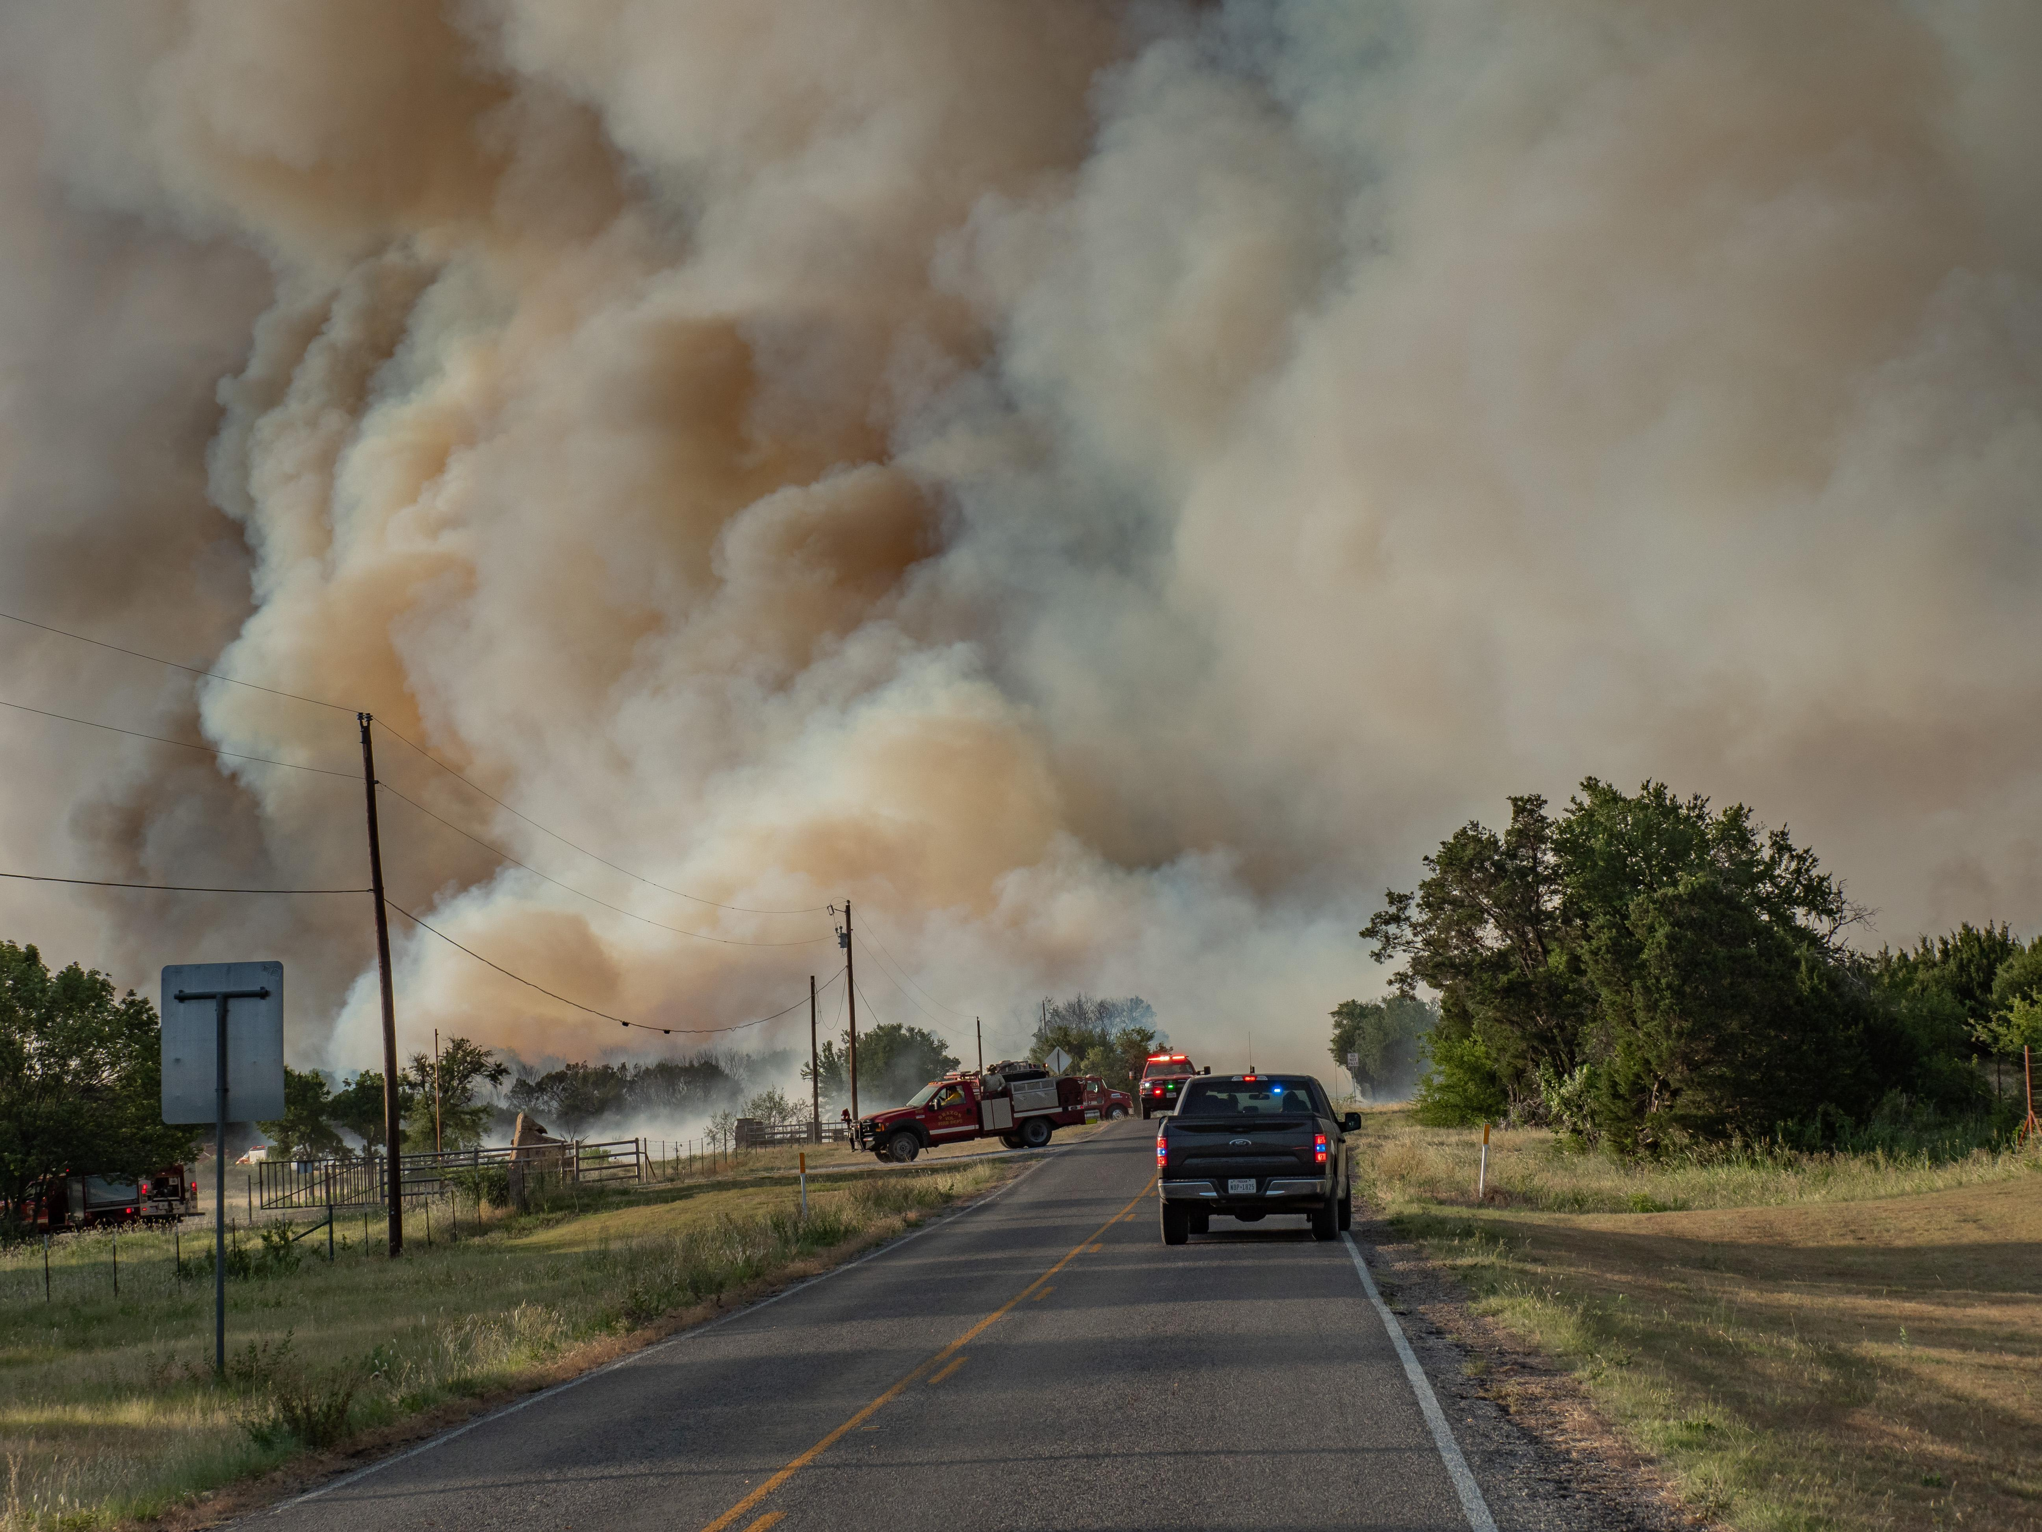
Visibility
Photo credit: USDA Forest Fire Service
Photo credit: National Interagency Fire Center
Notes:
Key principles include:
Outfit emergency vehicles with high visibility markings and emergency lighting compliant with applicable standards and regulations.
“Be Seen and Not Hurt.” Keep the scene well-lit so responders can be seen.
Direct scene lighting down at the operations area, not at drivers.
Extinguish forward-facing white lights on emergency vehicles so they do not interfere with drivers’ vision.
Dust, smoke, limited sight distance, and sharp curves are common on rural and unimproved roads, increasing visibility challenges.
Lefthand PHOTO - https://www.fs.usda.gov/managing-land/fire-old
Additional Case Study can be found at http:// www.cdc.gov/niosh/fire/reports/face200817.html

Slide 5
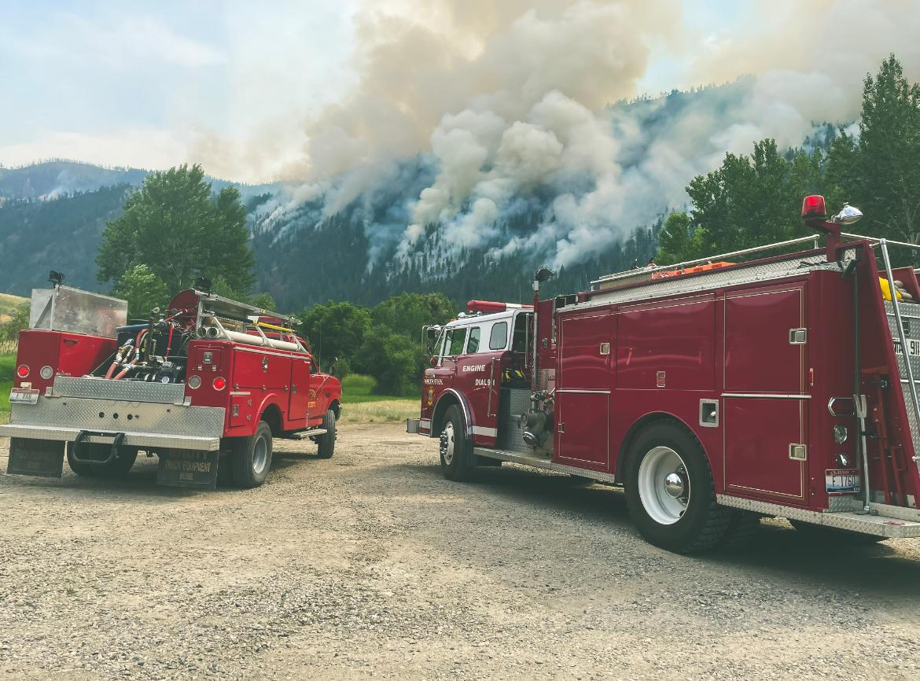
Blocking and Off-Road Operations
Photo credit: National Interagency Fire Center
Notes:
Key principles include:
Protect the operations area with an angled blocking apparatus.
Proper positioning of larger vehicles between moving traffic and emergency operations is key to providing a safety barrier for wildfire response personnel.
Be prepared to shut down the roadway, if needed, and be prepared to reposition if needed, for example for evacuation.
Blocking apparatus remains in place until operations being protected are complete.

Slide 6
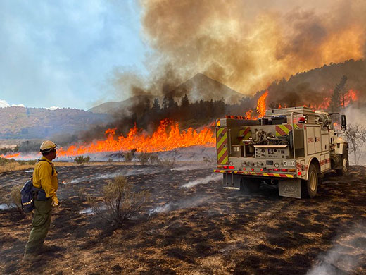
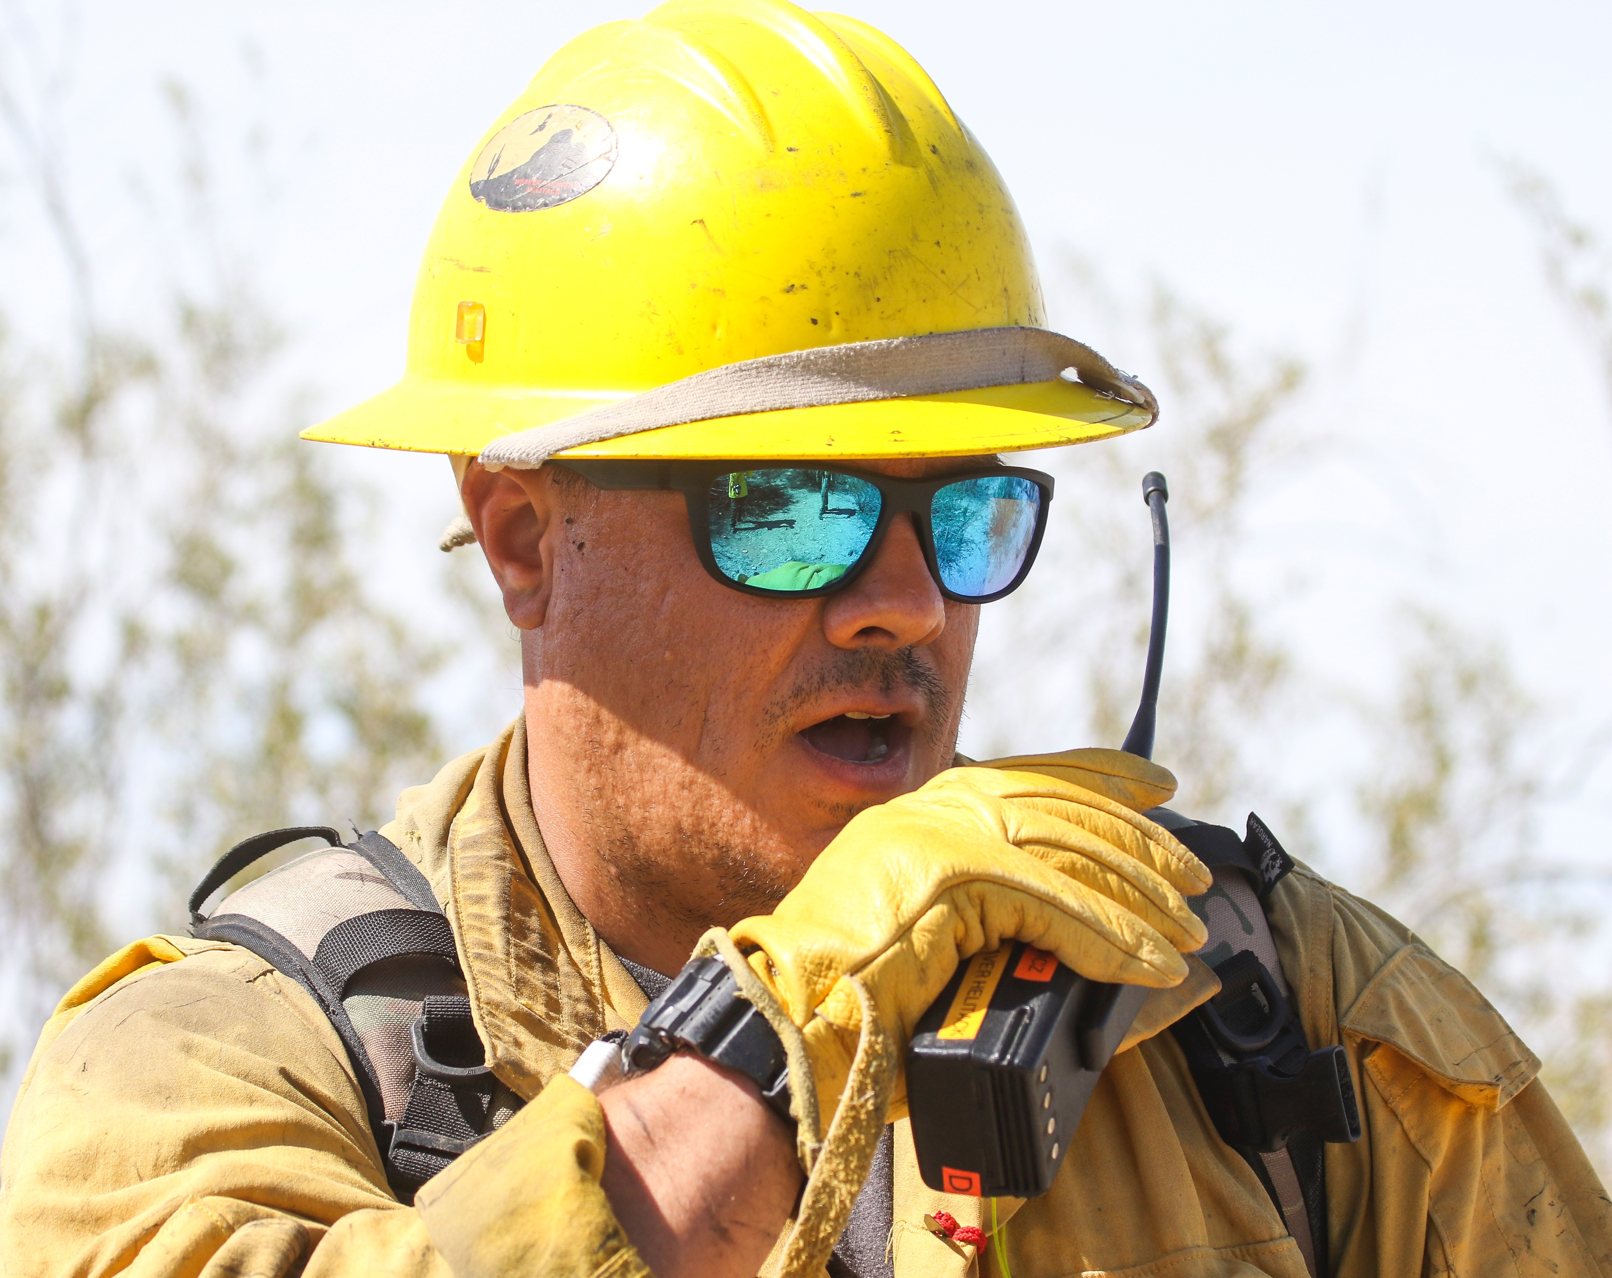
Backing Apparatus
Photo credit: Kansas Forest Service
Photo credit: National Interagency Fire Center
Notes:
Avoid backing emergency vehicles when possible. However, there will be times when the situation requires backing a vehicle, often quickly. Safe backing procedure specifics can vary, but a department’s backing up SOP should include:
A preference for avoiding backing up unless absolutely necessary.
A defined backing up procedure.
A requirement to use a trained spotter every time.*
A description of the roles and responsibilities of driver and spotter.
A high visibility PPE requirement.
A required 360º check of the backing area.
A description of hand signals and radio communication protocols between driver and spotter.
Required constant eye contact between spotter or backer and driver
Listing of situations requiring immediate stoppage of the apparatus, including when:
Eye contact with the spotter is lost
The driver is confused by signals or instructions
The driver receives visual, verbal, or radio communication to stop
Guidance for illumination of the spotter and backing area at night and enhanced equipment like lighted flashlight cones for hand signals.
Driver and spotter training evolutions for backing.
Consequences and enforcement procedures if the SOP is not followed.
Video of a recommended backing up procedure is available on ResponderSafety.com: https://www.respondersafety.com/training/backing-up-emergency-vehicles/
*Having a spotter is not a guarantee that nothing will go wrong; vigilance and following SOPs is needed. Training needs to be conducted and supervision needs to occur when any backing activity is in progress, especially near other moving traffic.
Photo: https://www.ksre.k-state.edu/news/stories/2020/08/kansas-forest-service-assists-on-wildfires.html

Slide 7
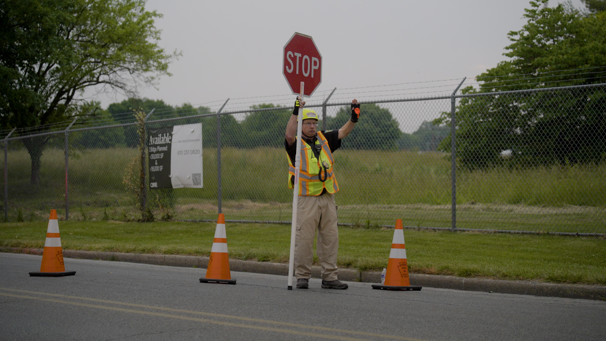
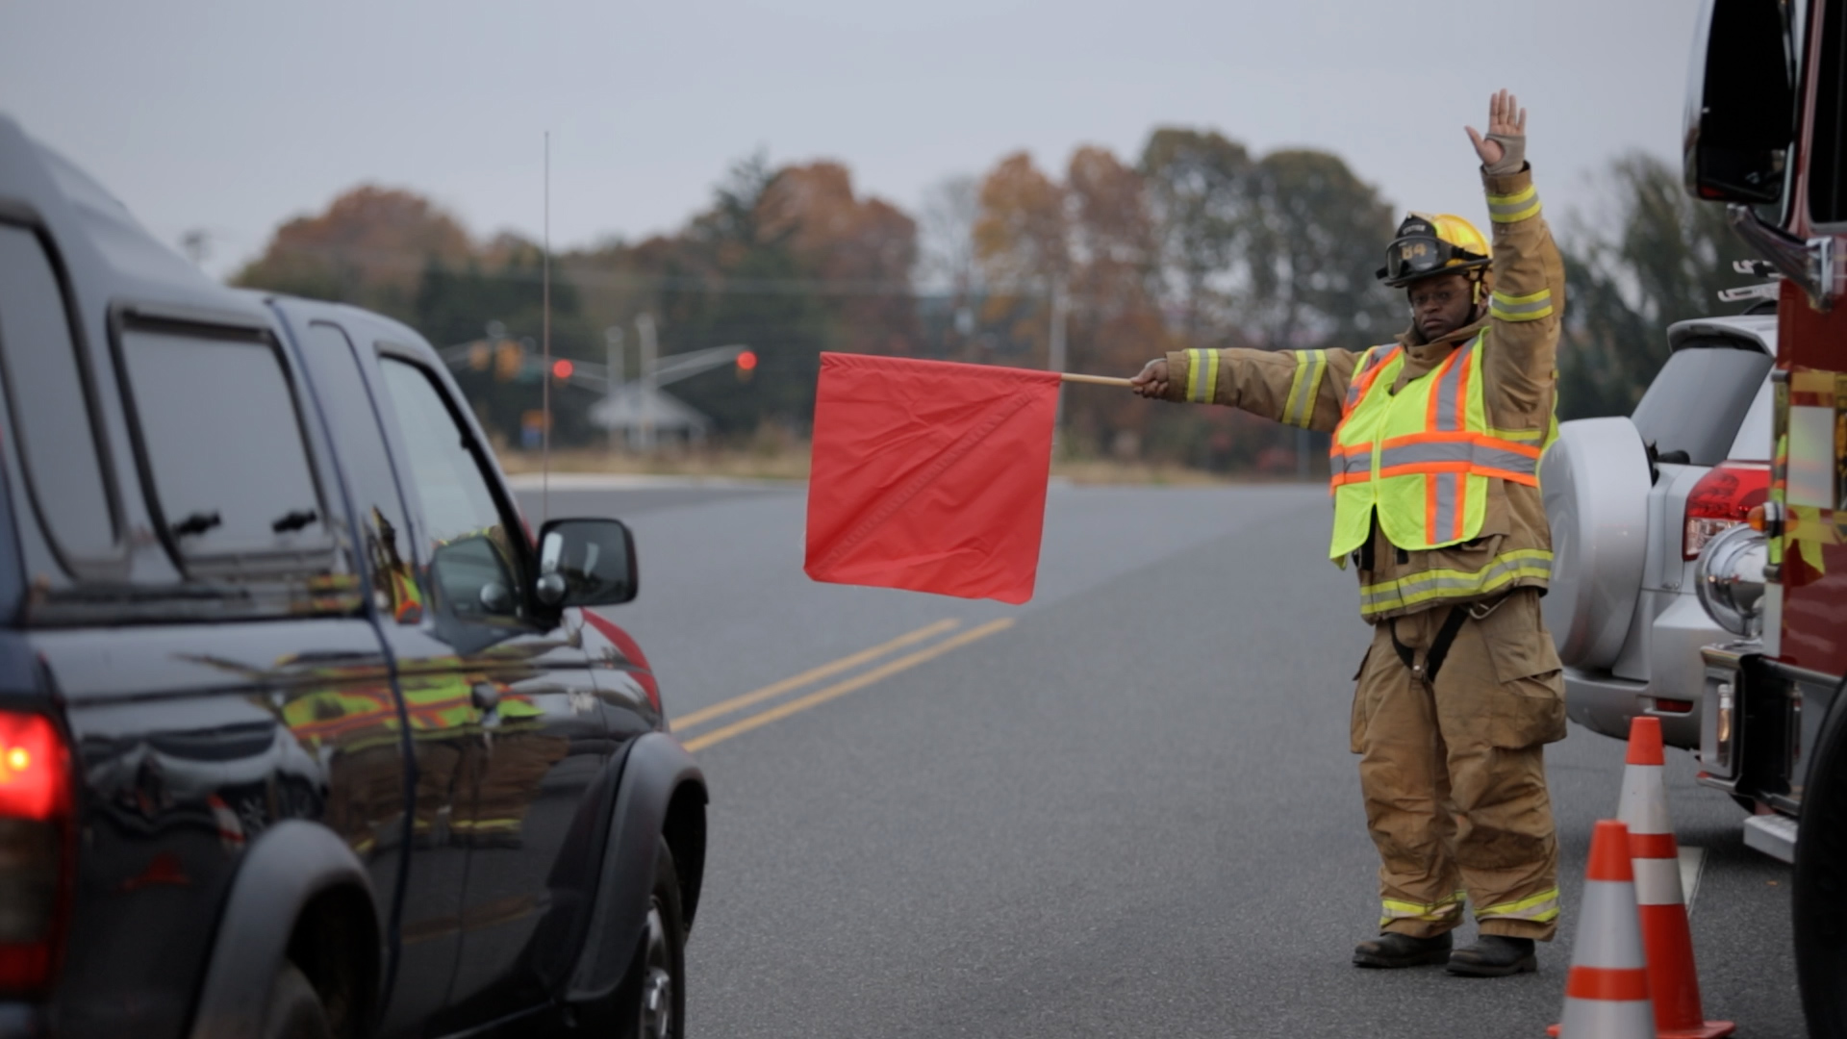
Personal Protective Equipment
Photo credit: ResponderSafety Learning Network
Notes:
Dress for the occasion.
Key principles include:
Dress for the occasion. Wear ANSI/ISEA 107-compliant high visibility apparel, a helmet, boots, and eye protection at all times.
If safety warrants it and there is no other way to provide a reasonable level of protection, don’t hesitate to completely shut down the roadway to protect personnel. Always close the road in consultation with law enforcement and implement detours.
Minimize closure time, keeping in mind that closure creates other hazards by stopping or re-directing traffic, particularly on major roadways and interstates.

Slide 8
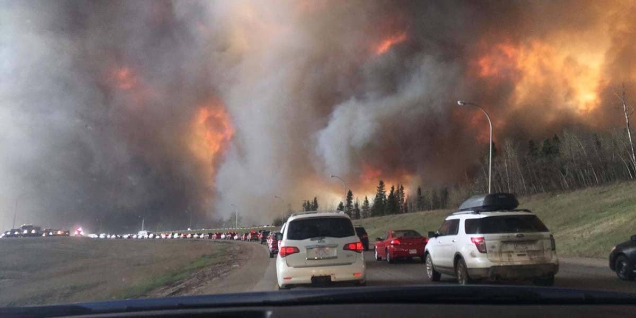
Evacuation
Photo credit: USFA
Notes:
Pre-planned and emergency evacuation procedures and routes are implemented at command’s direction. Incident command is responsible for assigning tasks and requesting resources to handle evacuation, how traffic is routed, how do emergency vehicles enter the evacuated area, and how law enforcement engages in the operation.
Be prepared to shut down the roadway for evacuation. Be prepared to implement traffic control devices and procedures for the evacuation.
If safety warrants it and there is no other way to provide a reasonable level of protection, don’t hesitate to completely shut down the roadway unless it is being used for evacuation.
Always attempt to do this in conjunction with law enforcement.
Keep the closure time to a minimum, keeping in mind you are creating other hazards by stopping or re-directing traffic, particularly on major roadways and interstates.
Along with this are pre-planned evacuation procedures and routes to be implemented at command’s direction.
Incident command is responsible for assigning tasks and requesting resources to handle this function, how traffic is routed, how do emergency vehicles enter the area, and how law enforcement engages in the operation.

Slide 9
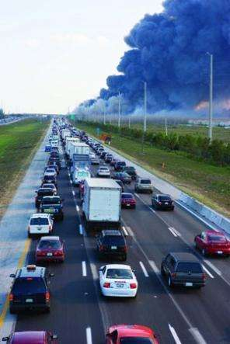
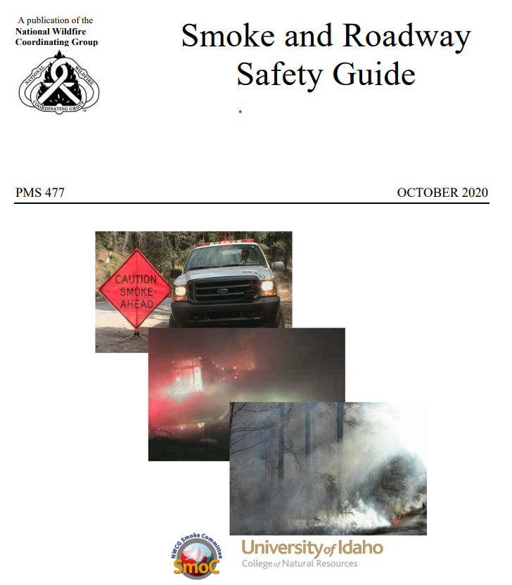
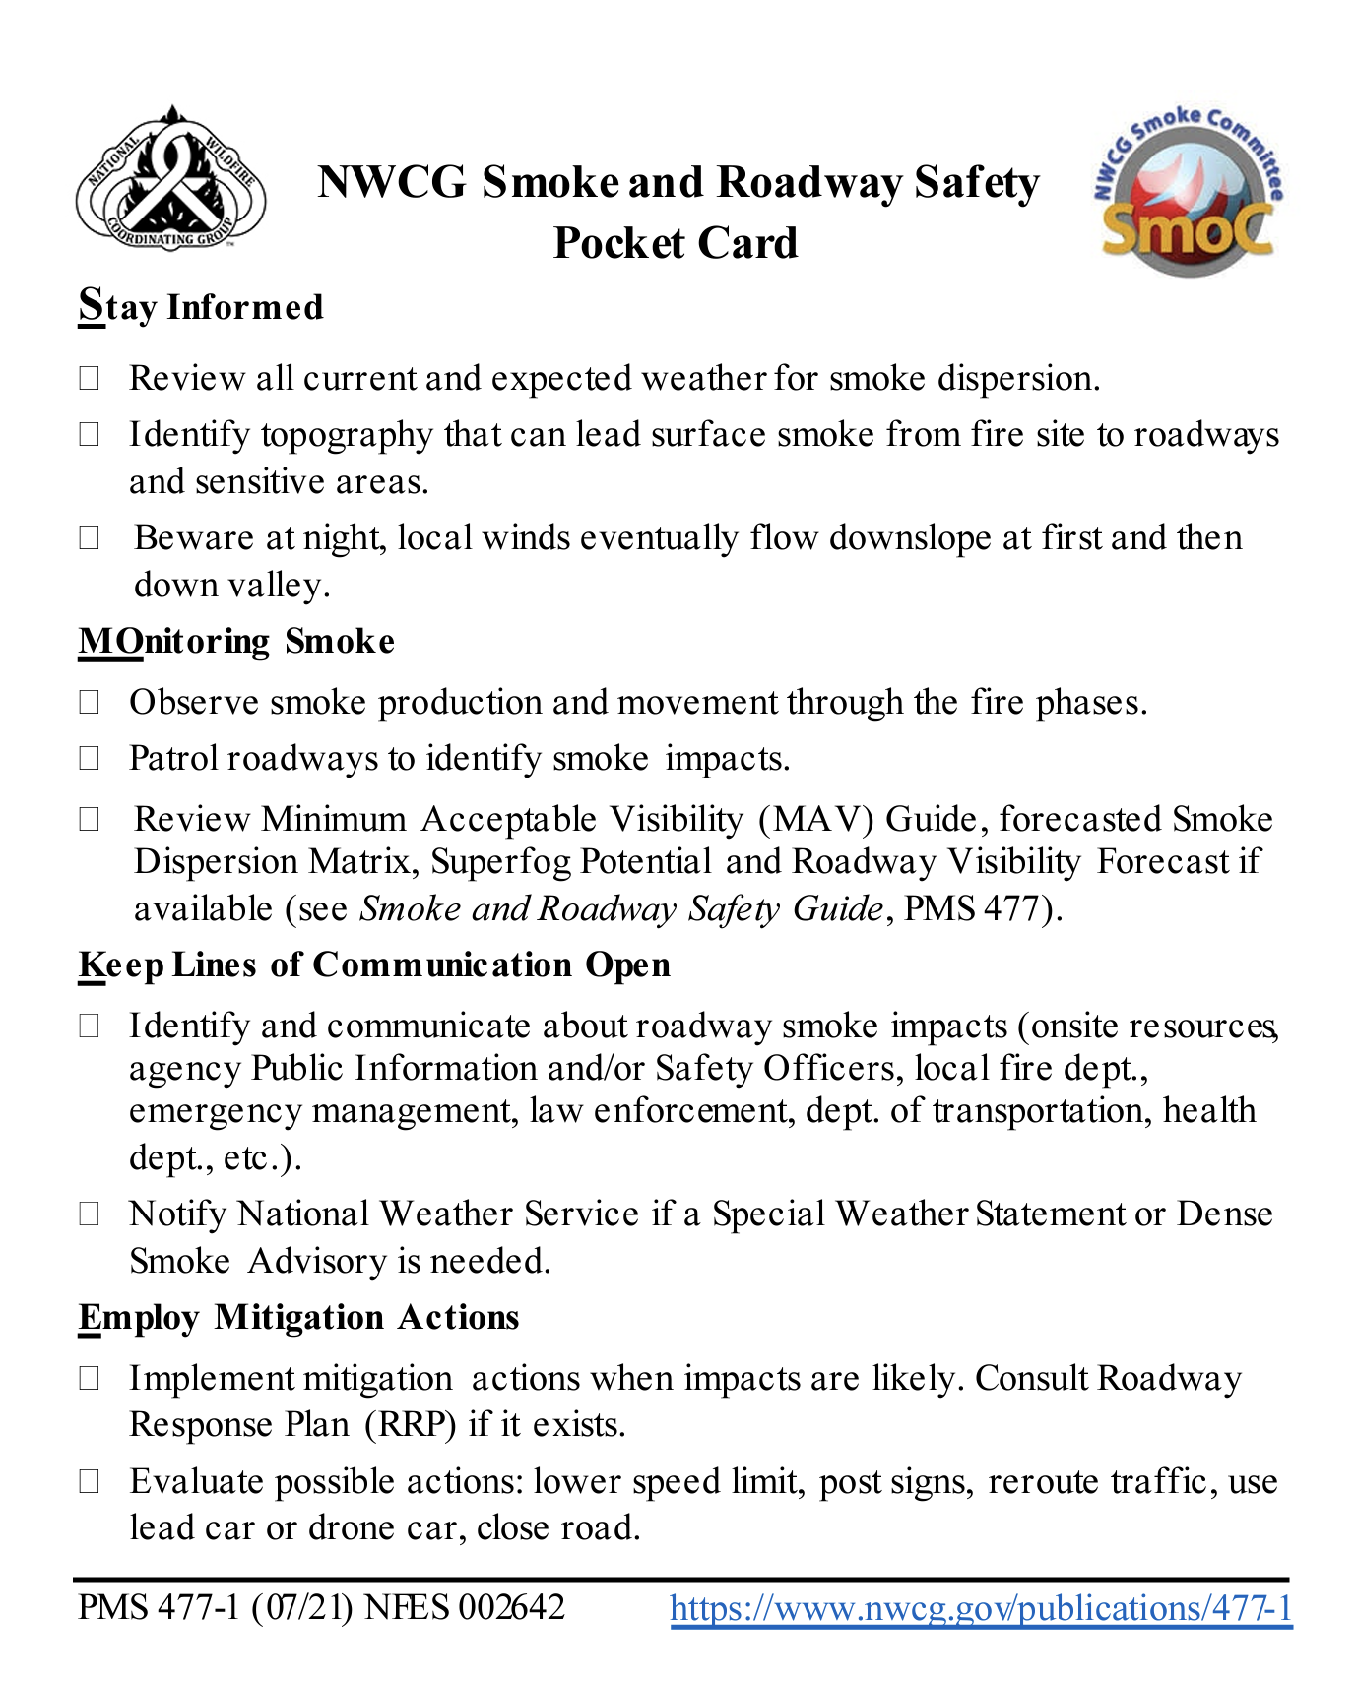
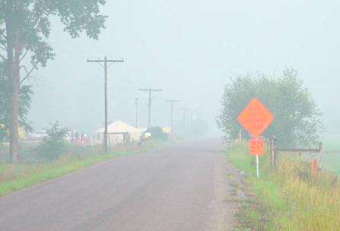
NWCG Smoke and Roadway Safety Guide
NCWG WUI mitigation guides PMS 051 and 052 may serve as reference
Photo credit: USFS
Notes:
The National Wildfire Coordinating Group’s Smoke and Roadway Safety Guide (PMS 477) and NWCG Smoke and Roadway Safety Pocket Card (PMS 477-1) provide excellent guidance in understanding the nature of the challenges smoke obscuration poses and developing the response organization’s approach to managing these challenges, including roadside response safety. The Guide suggests:
Anytime traffic flow is affected by an incident, contact the jurisdictional law enforcement agency for assistance.
Conduct all operations as far from traffic lanes as possible.
When working near traffic and not involved in fire suppression or containment activities, high visibility vests must be worn.
Park all vehicles on the same side of the roadway.
Exit the emergency vehicle on the side away from the roadway whenever possible.
Post lookouts to watch for and control traffic in both directions.
Use road flares or other advance warning and channelizing devices.
Operate pumps from the non-traffic side or from the cab of the fire apparatus.
Keep all hose, fire tools, and equipment out of traffic lanes.
Assessing safety risks to personnel and public posed by smoke on roads
During initial attack and/or daily size-up on extended attack, evaluate the potential of smoke to impact roadways up to 10 miles away.
Identify drainages and topographic features that may allow smoke to impact roadways during the night and early morning.
Establish local fire and traffic movement baselines or thresholds that, when combined with smoke, indicate that the potential for reduced roadway visibility exists and TIM practices need to be modified.
Stay vigilant on key weather variables, such as
Critical surface temperature
Relative humidity
Surface wind speed
Cloud cover
and mitigate roadway visibility hazards accordingly.
NCWG WUI mitigation guides PMS 051 and 052 may serve as reference
https://www.nwcg.gov/sites/default/files/publications/pms052.pdf

Slide 10
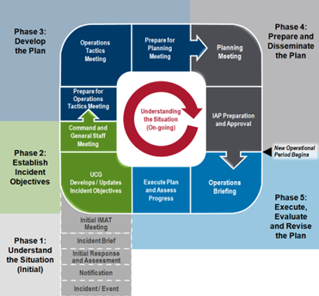
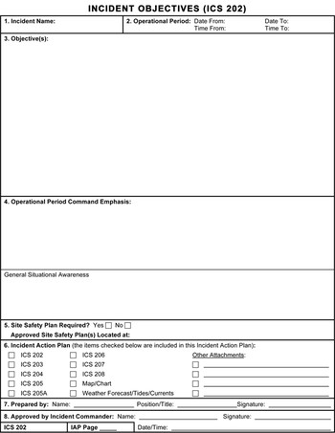
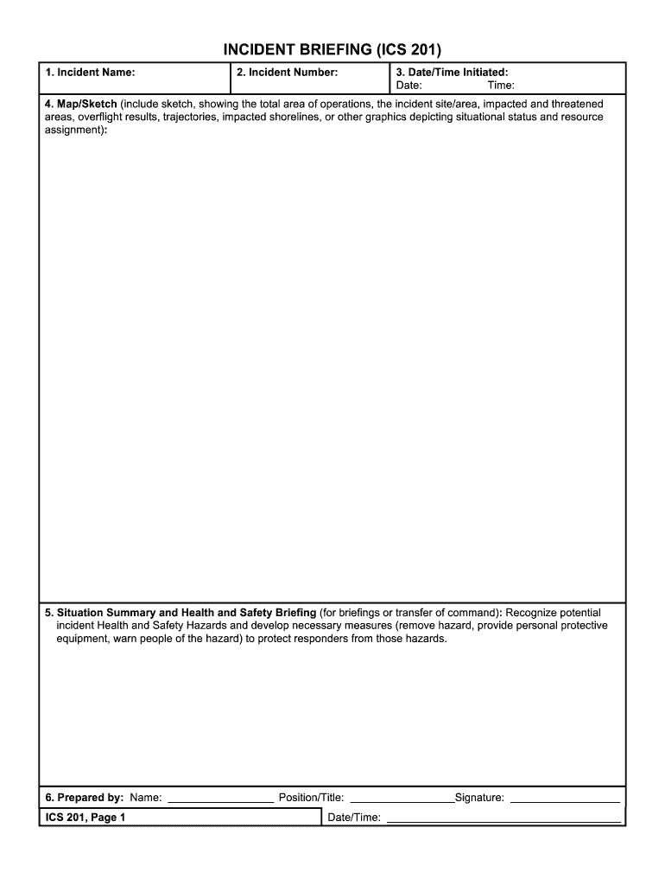
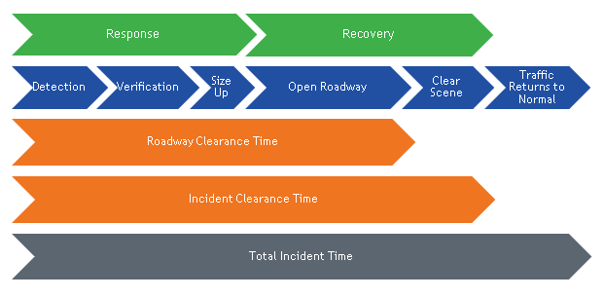
ICS and TIM IAP
Notes:
The topics and guidelines discussed in Protecting Emergency Responders from Moving Vehicles During Wildfire Responses are written to align with the core principals of the National Incident Management System (NIMS) and Incident Command System (ICS). Traffic Incident Management (TIM) integrates the transportation professional into NIMS and ICS. Of particular note are ICS Form 201 and ICS Form 202.
While maintaining or restoring traffic flow is the transportation profession’s goal, traffic incident response priorities include:
Life Safety
Incident stabilization
Preservation of property and environment
Maintaining or restoring traffic flow

Slide 11

Review SOGs Specific to YOU!
Notes:
At the organizational level, develop and/or review related Standard Operating Guidelines, prior to initiating wildfire-related traffic management practices (refer to the Resources & References section of this report for more information).
At this point, you should review any Standard Operating Guidelines specific to your team or operation, that deal with Traffic Management at Wildland events.
If you do not have a specific SOG, simply reviewing the key points presented in this report, taking the recommended training, and using the provided resources will help you better understand the challenges YOU face, and how YOU should handle those challenges.

Slide 12
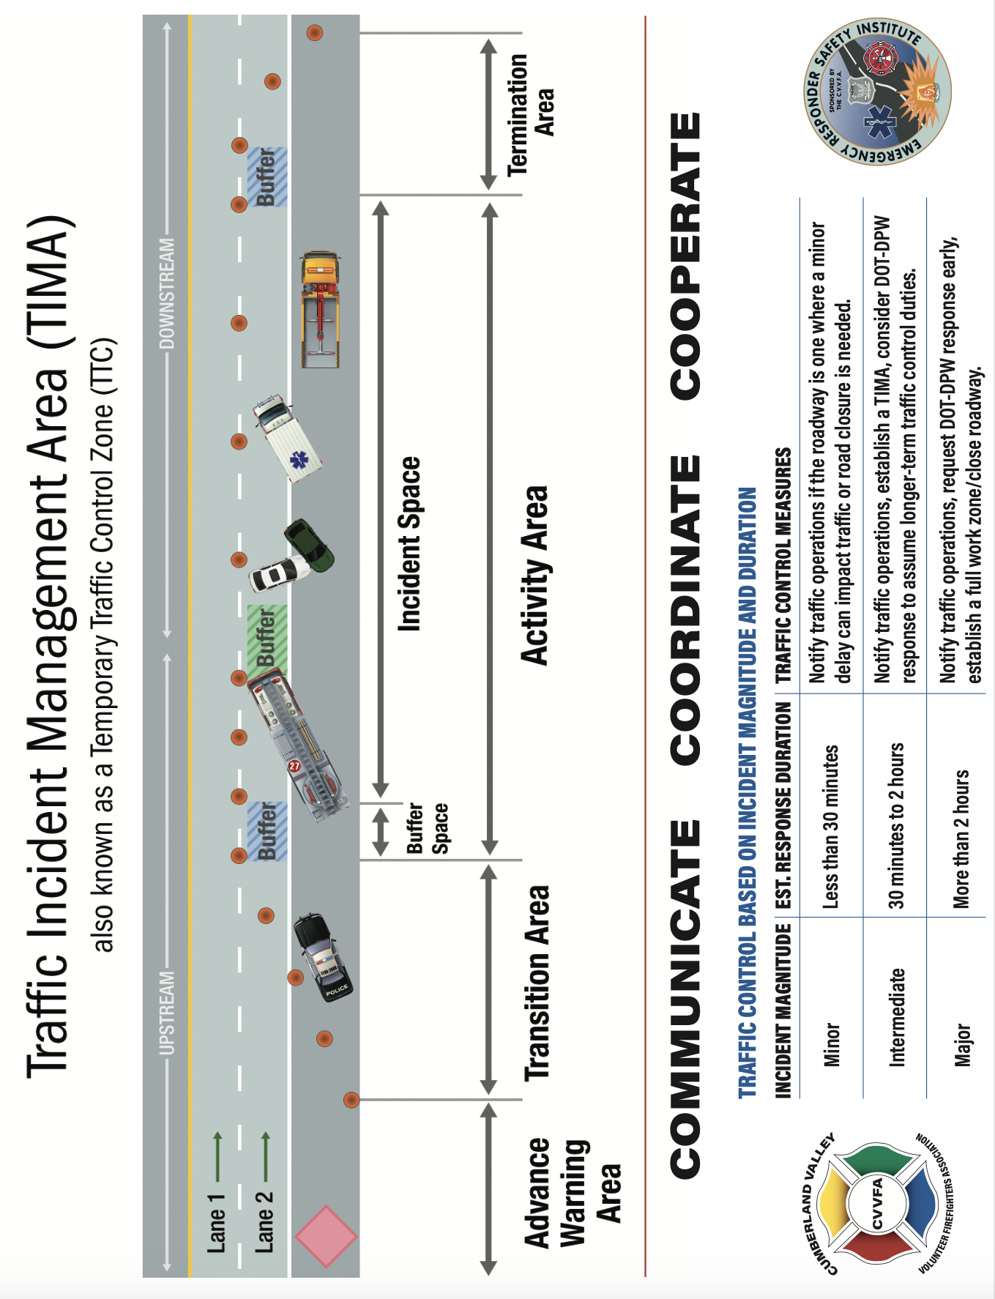
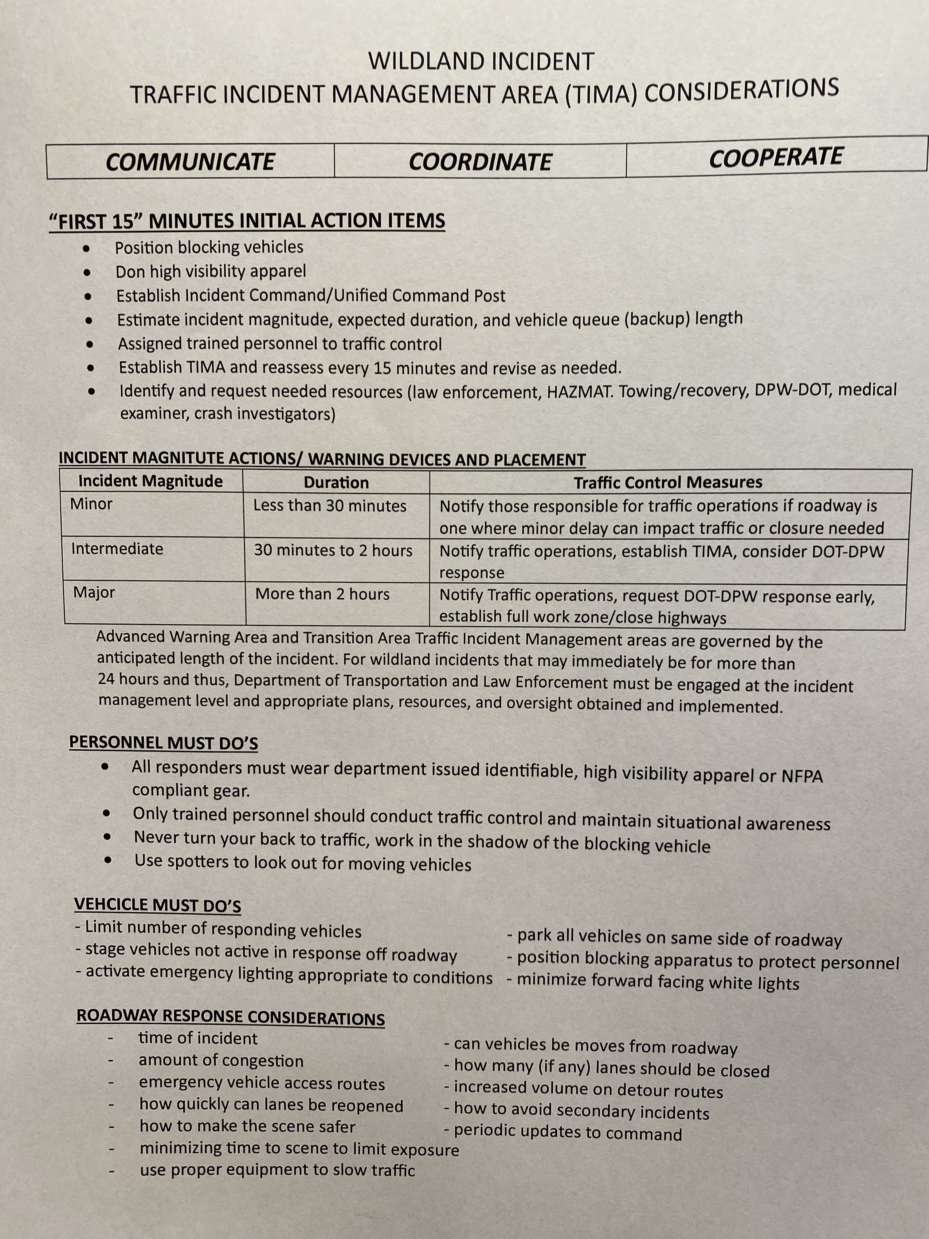
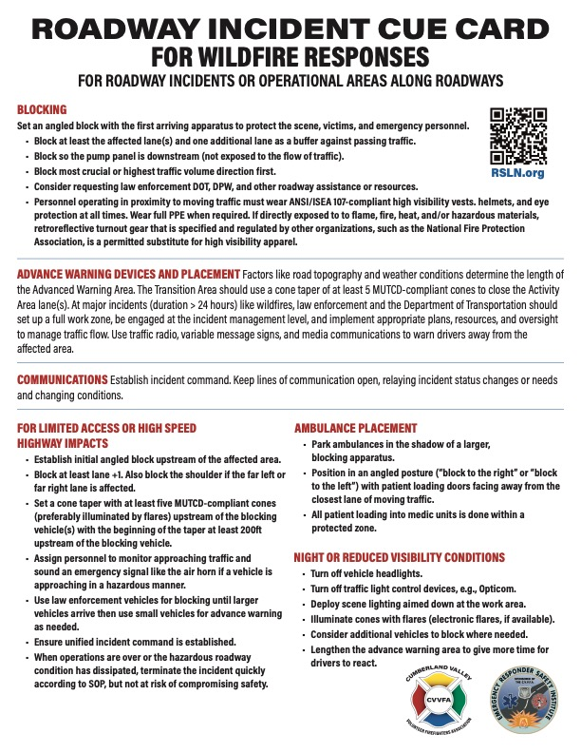
Reference items in the field
WILDLAND ROADWAY INCIDENT “TIM CUE CARD”
FOR ACCIDENT AREAS OR OPERATIONAL AREAS ALONG HIGHWAYS
“Block” with first arriving apparatus to protect the scene, patients, and emergency personnel.
Block at least one additional lane
Block so pump panel is “down stream”
Block most crucial or highest traffic volume direction first
Consider requesting additional law enforcement assistance
Consider requesting DOT/DPW/other highway resources
Crews wear public safety vests and helmets at all times, full PPE when required
WARNING DEVICES AND PLACEMENT
Advanced Warning Area and Transition Area Traffic Incident Management areas are governed by the anticipated length of the incident. For wildland incidents that may immediately be for more than 24 hours and thus, Department of Transportation and Law Enforcement must be engaged at the incident management level and appropriate plans, resources, and oversight obtained and implemented.
COMMUNICATIONS
Keep lines of communication open, relaying incident status changes or needs and changing conditions.
SAFETY
Consider assigning a Safety Officer and an upstream “spotter” if necessary.
AMBULANCE PLACEMENT
Park ambulances in the shadow of larger apparatus
All patient loading into medic units is done from within a protected zone.
Lane 1 is furthers right lane, next is lane 2, then lane 3 from approaching motorist’s point of view.
Direct ambulance to “block to the right” or “block to the left” to protect loading doors.
Place ambulance patient loading area facing away from the closest lane of moving traffic.
FOR LIMITED ACCESS OR HIGH VOLUME HIGHWAY INCIDENTS
Establish initial block – minimum two lanes
Establish an upstream block
Two lanes plus shoulder
Three driving lanes
Place cones and/or cones illuminated by flares upstream of blocking vehicles with last cone 200ft upstream of
apparatus.
Establish flagger position
Monitoring approaching traffic and sound emergency signal as necessary (apparatus operator sounds air horn
blasts as necessary
Use law enforcement vehicles for additional blocking
Assure unified incident command is established
Terminate incident aggressively, but not at risk of compromising safety
NIGHT OR REDUCED LIGHT CONDITIONS
Turn off vehicle headlights
Turn off traffic light control devices
Provide overall scene lighting
Illuminate cones with flares
Consider additional vehicles to block where needed
Notes:
It is important to have reference items that can used in the field, as it is impossible to remember everything. There are specific items already referenced, but two tools were developed specifically for this initiative, the “Roadway Incident Cue Card” and the Traffic Incident Management Area for Wildland Incident reference card.

Slide 13
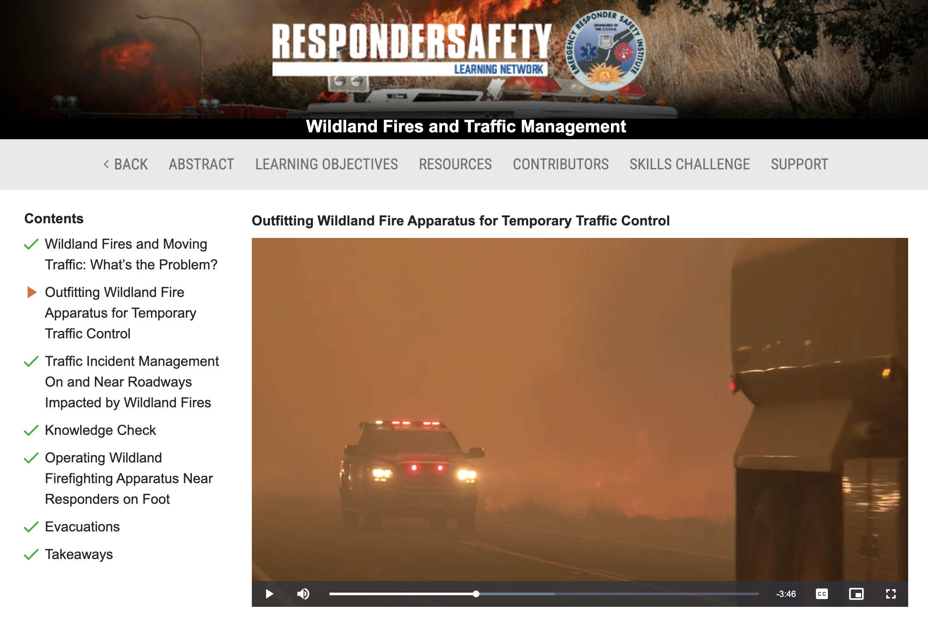
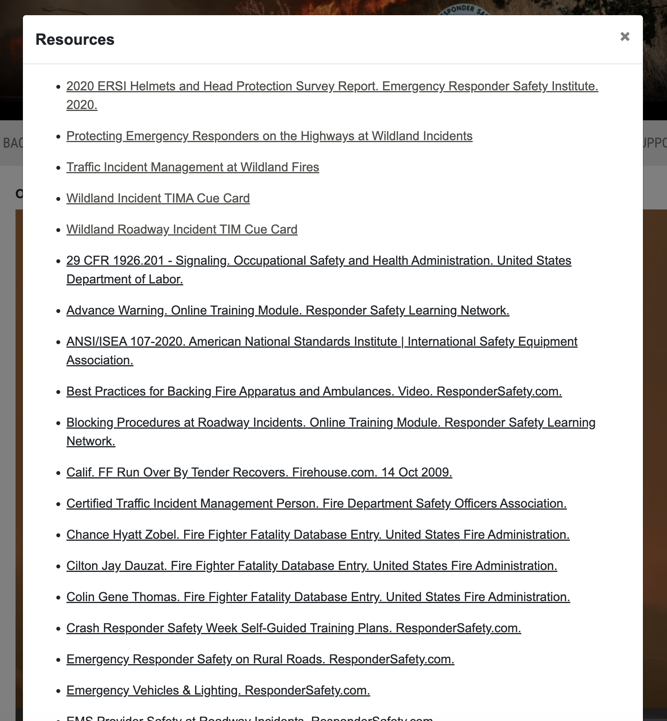
Additional Training
Notes:
If your personnel have already taken this training, suggest they periodically review it as refresher.
Register for and complete the Responder Safety online training module, “Wildland Fires and Traffic Management”
Go to https://learning.respondersafety.com/ and register. There is no charge.
Complete the program “Wildland Fires and Traffic Management.” https://learning.respondersafety.com/Training_Programs/Wildland-Fires-and-Traffic-Management.aspx
The Resources tab in the module lists related support materials as part of this training.
For refresher in the field, reference the tools developed for this project, which are available in the Resources & References section of this report:
Roadway Incident Cue Card for Wildfire Responses
Implementing a Traffic Incident Management Area at Wildfires

Slide 14
References
National Wildfire Coordinating Group, “Smoke and Roadway Safety Guide”, PMS 477, October, 2020.
NWCG Smoke and Roadway Safety Pocket Card, PMS 477-1 (07/21) NFES 002642 https://www.nwcg.gov/publications/477-1
Responder Safety Learning Network at http://https://learning.respondersafety.com/
ResponderSafety.com
VFIS Risk Communique, “Highway Incident Safety”, VFIS, 2022.

