Slide 1
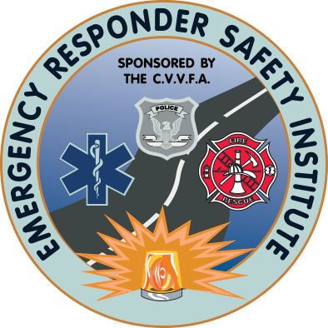


Traffic Incident Management at Wildfires
Funded By:
Notes:
This presentation accompanies the report, Protecting Emergency Responders from Moving Vehicles During Wildfire Responses.
Despite recent severe wildfire seasons, little attention has been paid to responder safety and traffic incident management during these events. Several struck-by* line-of-duty deaths have occurred at wildfire responses. These events have involved smoke obscuration causing low visibility on the roadway, insufficient vehicle backing safety practices, and improper boarding of firefighting apparatus. As buildings and infrastructure encroach further on undeveloped land, wildfire flames and smoke will affect more moving traffic on roadways. In addition, movement of wildland firefighting vehicles both on and off road pose a struck-by hazard to wildland firefighters. The goal of this project is to develop practical training in:
Traffic incident management recommended practices for roadways affected by wildland fires and firefighting operations.
Safety procedures to follow when wildland firefighting vehicles are operating near responders on foot, whether that is on a road or in the back country.
Important note: This program focuses solely on traffic control and the safety of responders operating near vehicles at a wildfire. Other safety aspects of wildfire response are outside the scope of this project.
*A struck-by incident is defined as incidents produced by forcible contact or impact between the injured person/damaged equipment and a separate striking object or piece of equipment.

Slide 2
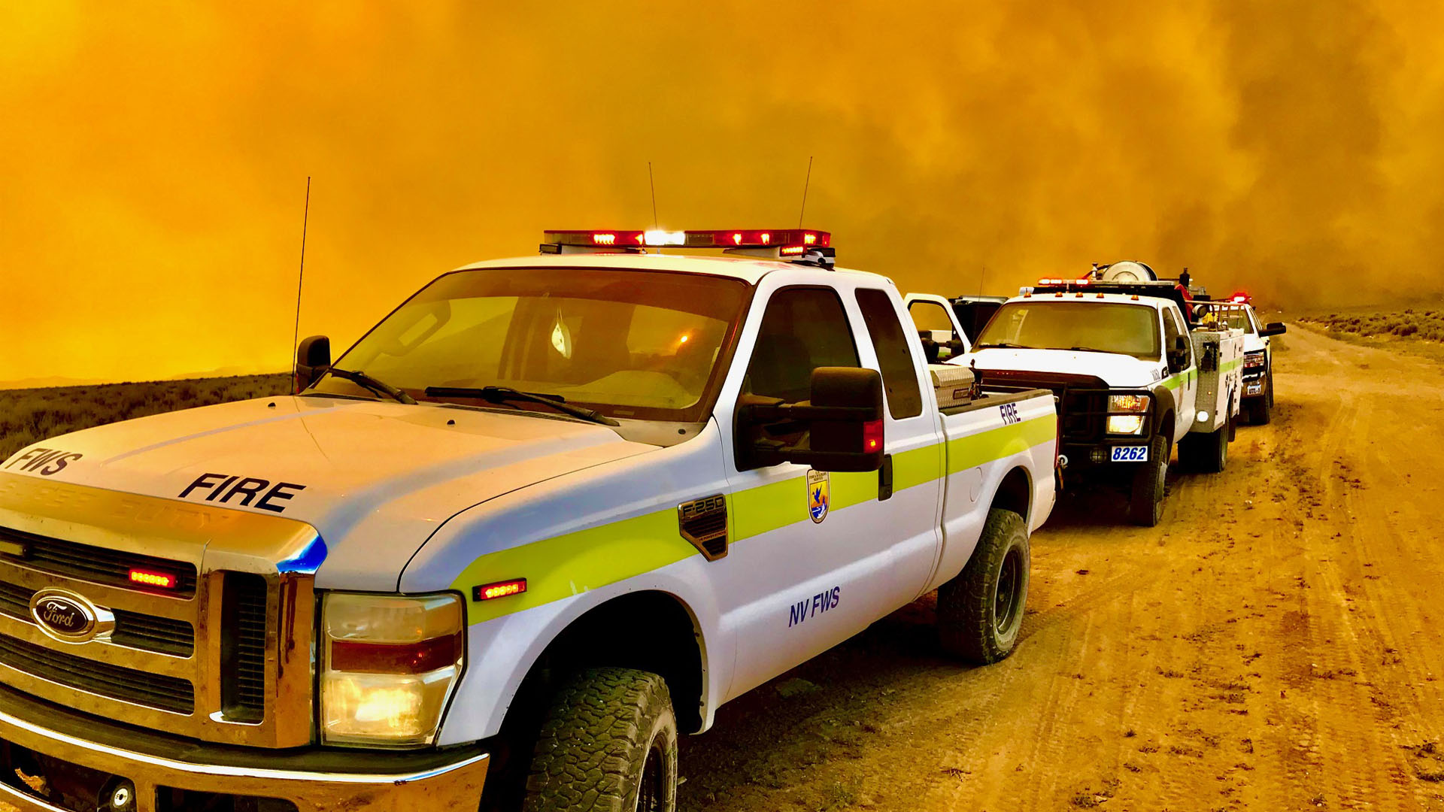
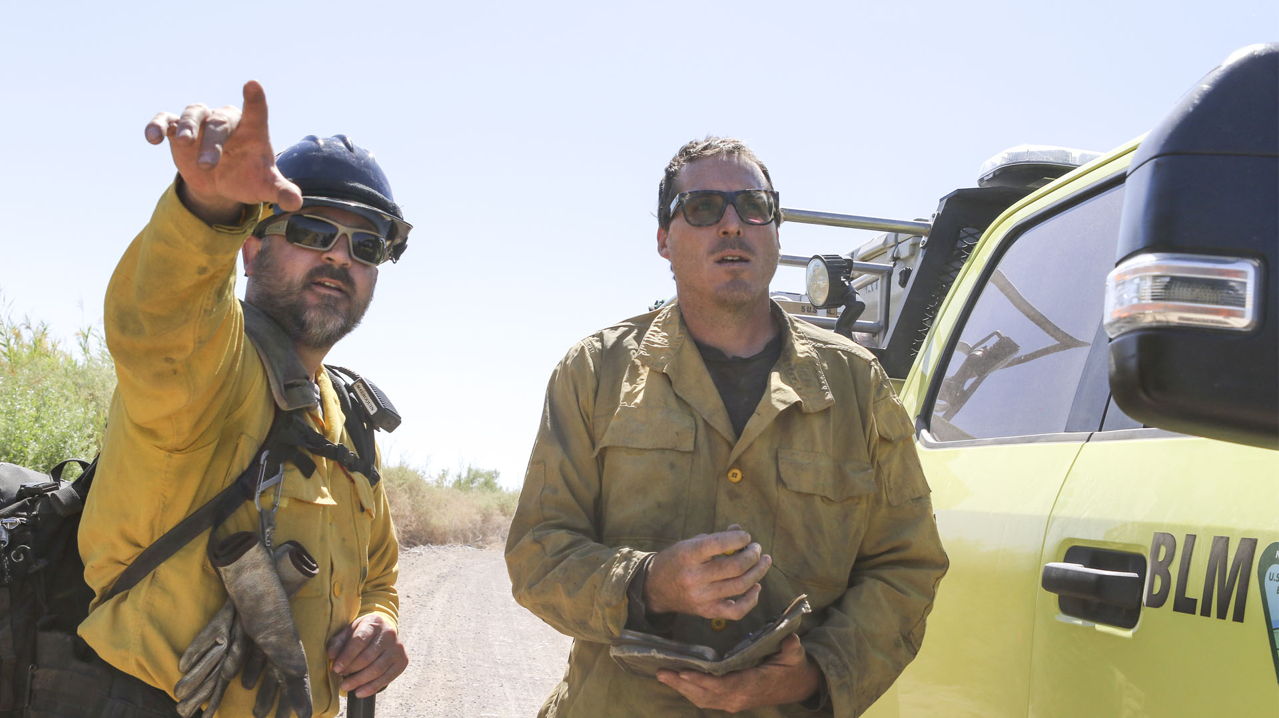
Traffic Incident Management (TIM) Defined
Traffic incident management (TIM) is a planned, coordinated, multi-disciplinary process to detect, respond to, and clear traffic incidents and assist at incidents so that traffic flow may be restored, or occur, as safely and quickly as possible.
Photo credit: National Interagency Fire Center
Notes:
First, let’s understand what Traffic Incident Management means. Traffic incident management (TIM) is a planned, coordinated, multi-disciplinary process to detect, respond to, and clear traffic incidents and assist at incidents so that traffic flow may be restored, or occur, as safely and quickly as possible.
At many incidents, public safety agencies use a Traffic Operations Center (TOC). However, in a wildland urban incident, TOC may mean a Tactical Operations Center. Clarity must be reinforced. Finally, the acronym DPW or department of public works may be used in some regions of the United States. As personnel respond from around the country to some wildland urban incidents, clarity on the definition of acronyms and terms is an essential first step.
TIME SHOULD BE TAKEN AT THIS POINT TO ASSURE ALL PARTICIPANTS UNDERSTAND THE TERMS AND ACRONYMS THAT WILL BE USED LOCALLY.

Slide 3
Objectives
At the conclusion of this session, the learner should be able to:
Explain why traffic control is important at wildfire responses.
Describe the hazards that emergency responders face from moving vehicles at wildfire responses.
List contributing factors in struck-by line-of-duty deaths at wildfire responses and associated recommendations to address these contributing factors.
Explain how traffic incident management fits into the incident management plan.
Notes:
At the conclusion of this session, the learner should be able to:
Explain why traffic control is important at wildfire responses.
Describe the hazards that emergency responders face from moving vehicles at wildfire responses.
List contributing factors in struck-by line-of-duty deaths at wildfire responses and associated recommendations to address these contributing factors.
Explain how traffic incident management fits into the incident management plan.

Slide 4
Objectives
At the conclusion of this session, the learner should be able to:
Explain the key elements of a risk assessment as it pertains to traffic incident management at wildfire responses.
Explain actions to take at wildfire responses to address struck-by-vehicle hazards, including traffic control and responder safety practices.
Describe the struck-by hazards present during evacuations and how to mitigate those hazards.
List takeaways for the learner's role at wildfire responses that match their responsibilities for responder safety and traffic control actions to reduce struck-by-vehicle hazards.
Notes:
At the conclusion of this session, the learner should be able to:
Explain the key elements of a risk assessment as it pertains to traffic incident management at wildfire responses.
Explain actions to take at wildfire responses to address struck-by-vehicle hazards, including traffic control and responder safety practices.
Describe the struck-by hazards present during evacuations and how to mitigate those hazards.
List takeaways for the learner's role at wildfire responses that match their responsibilities for responder safety and traffic control actions to reduce struck-by-vehicle hazards.

Slide 5
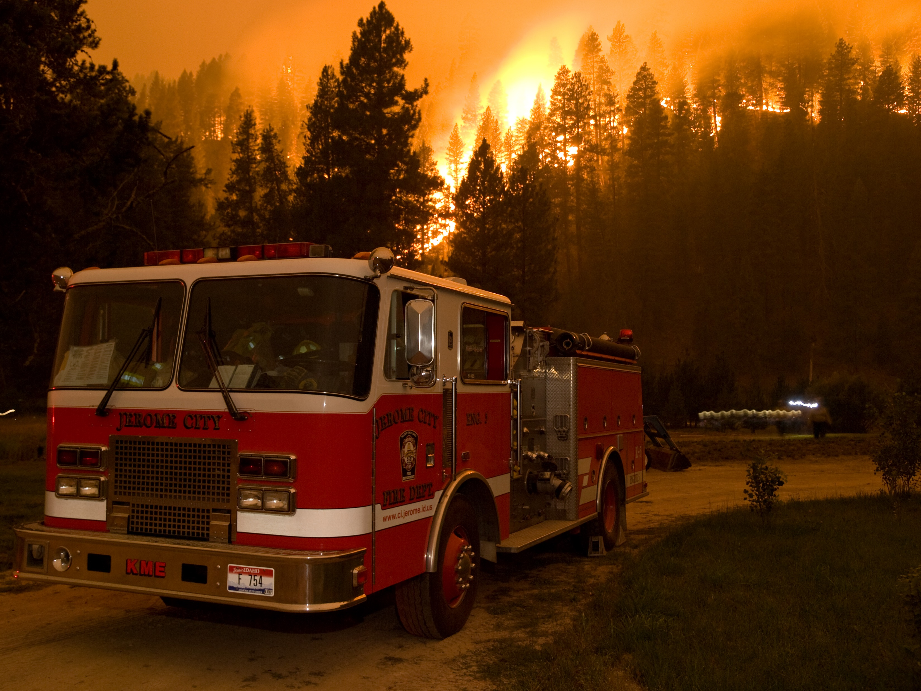
Common Contributing Factors to Wildfire Traffic-Related Incidents
Lack of adequate traffic controls
Responders standing in or traversing active roadways
Decreased visibility due to smoke
Dark or poorly lit conditions
Failure to assess needs
Failure to communicate
Lack of inclusion of traffic incident management
at the incident command level
Notes:
The subject matter experts on this project worked with existing local, regional, state, national and federal agencies to collect current content on the subject. This data, along with an analysis of prior vehicle-related incidents at wildfires identified seven common contributing factors:
Lack of adequate traffic controls
Responders standing in or traversing active roadways
Decreased visibility due to smoke
Dark or poorly lit conditions
Failure to assess needs
Failure to communicate
Lack of inclusion of traffic incident management at the incident command level
These contributing factors partially form the basis of the training approach developed for this project.

Slide 6
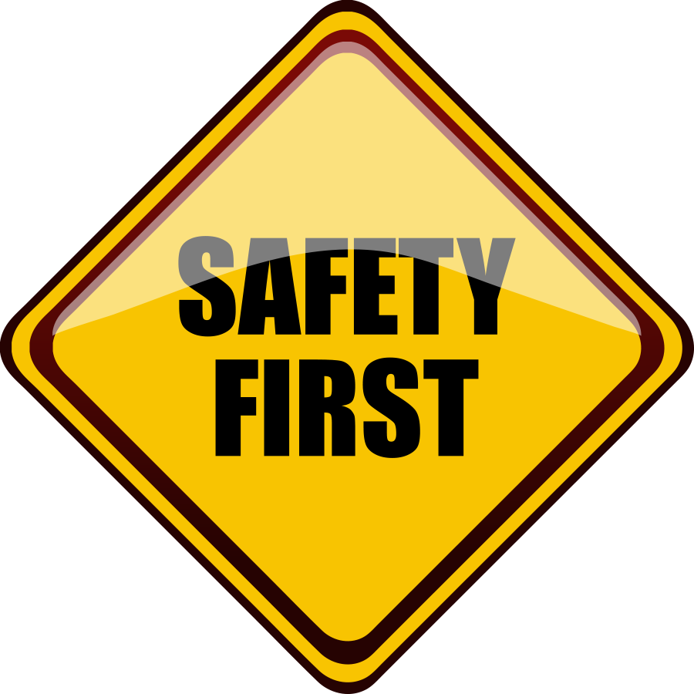
Key Safety Considerations
Life safety is the first priority. Saving property and natural resources is the second priority.
Know where escape routes and safety zones are.
Maintain situational awareness:
  Fire development
  Access/retreat areas
Keep an eye on potential problem areas.
Know and adhere to equipment placement guidelines.
Establish strong communications with all involved agencies.
Notes:
There are several overriding foundational safety principles to consider:
Life safety is the first priority. Saving property and natural resources is the second priority.
Know where escape routes and safety zones are at all times.
Maintain situational awareness:
Fire development
Access/retreat areas
Keep an eye on potential problem areas, especially managing emergency and civilian traffic.
Know and adhere to equipment placement guidelines.
Establish strong communications with all involved agencies, including understanding everyone’s role in the command structure.
Additional wildfire safety information can be found on pages 11 through 15 of the National Wildfire Coordinating Group’s Incident Response Pocket Guide, PMS 461 (NWCG-IRPG).

Slide 7
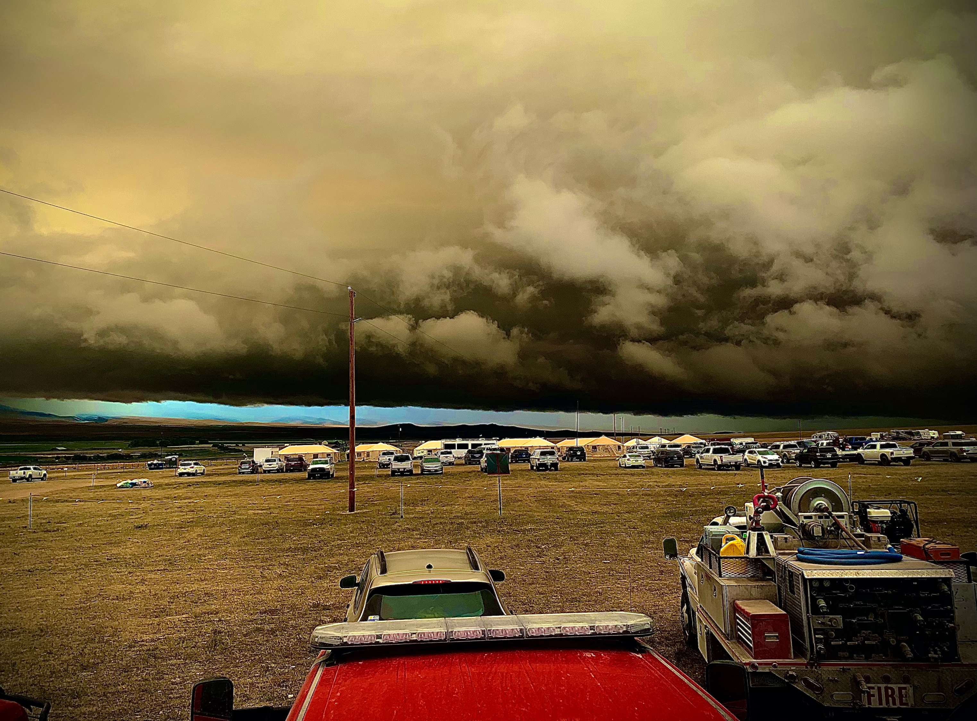
Heads Up
Fire development
Weather
Poor access and traffic congestion
Dangerous road and bridge conditions
Power lines, flammable tanks, and other hazards
Photo credit: National Interagency Fire Center
7
Notes:
Be heads up about
Fire development
Weather
Poor access and traffic congestion
Dangerous road and bridge conditions
Power lines, flammable tanks, and other hazards
Additional wildfire safety information can be found on pages 11 through 15 of the National Wildfire Coordinating Group’s Incident Response Pocket Guide, PMS 461 (NWCG-IRPG).

Slide 8
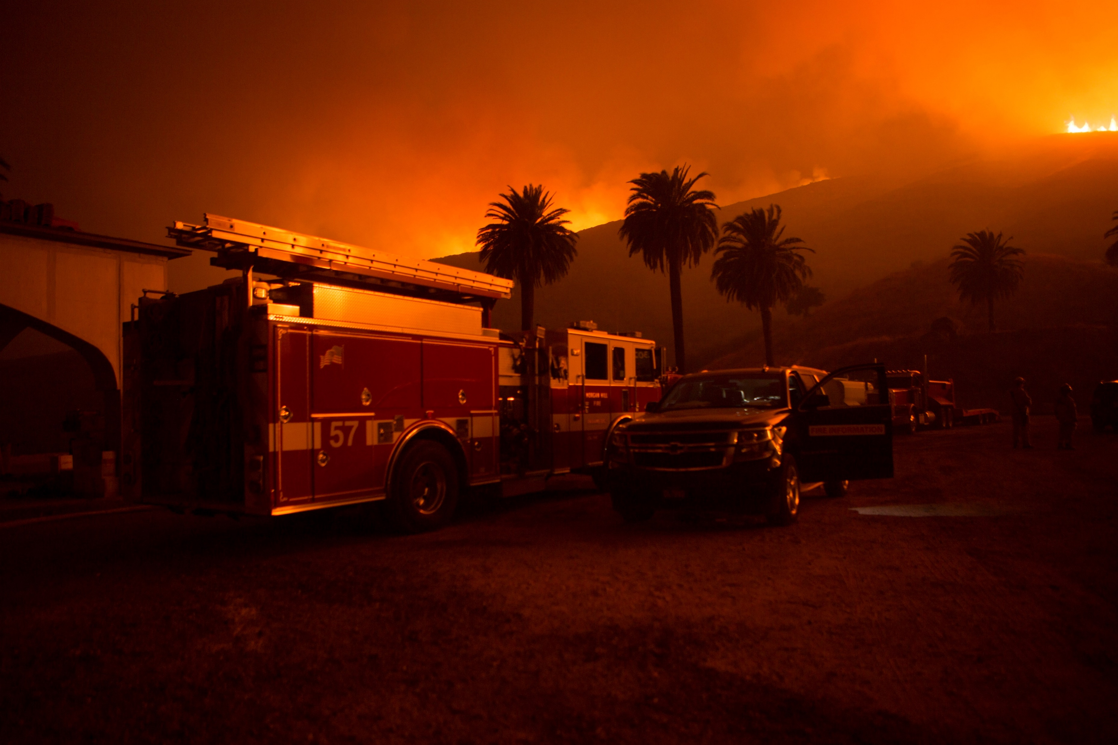
Avoiding and Mitigating Wildfire Traffic-Related Incidents
Cooperative interagency planning for safe operations prior to an incident:
  Policies
  Response procedures
  Resource allocation
  Training
  Contingencies
Command assignment of traffic control actions (IAP, safety plan).
For traffic control implementation,
determine what, how, when, and who.
Plan for contingencies.
Notes:
Addressing the contributing factors to real-world struck-by incidents at wildfires suggests we consider ways to avoid and/or mitigate traffic-related incidents at these fire events. Some ways to achieve this include:
Cooperative interagency response planning prior to an incident, including policies, response procedures, resource allocation, training, and contingencies
Implementing traffic control at the scene begins with incident command assigning traffic control tasks. This should be part of the Incident Action Plan (IAP), and related safety plan
Creating the traffic incident management plan during the pre-planning process includes defining what measures will be taken, how traffic control will be implemented, when it will be implemented, and who will implement it
The TIM plan should have contingencies for situations where the primary traffic control agency is not on scene.

Slide 9
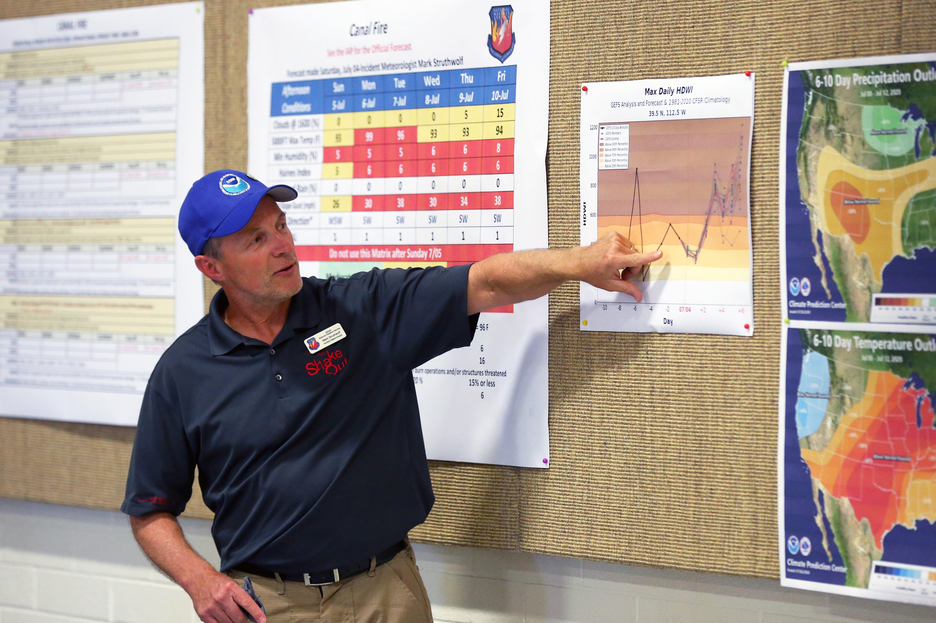
Addressing Contributing Factors at the Organizational Level
Evaluate department training, equipment, and procedures to determine with respect to operations on/near roadways and traffic control.
Establish an agreement and pre-incident plans with partner agencies who can provide traffic control.
Engage in public education about safe driving practices near wildfire scenes.
Know what advance warning methods are available.
Photo credit: National Interagency Fire Center
Notes:
At the organizational level, address known contributing factors with these recommended actions:
Evaluate department training, equipment, and procedures to determine if they are sufficient for operating on or near roadways and meet traffic control needs at wildfire responses.
If needed, establish an agreement and pre-incident plans with partner agencies who can provide traffic control.
Engage in public education about safe driving practices near wildfire scenes.
Know what advance warning methods are available in jurisdictions where the department responds to wildfires and how to use or activate them.

Slide 10
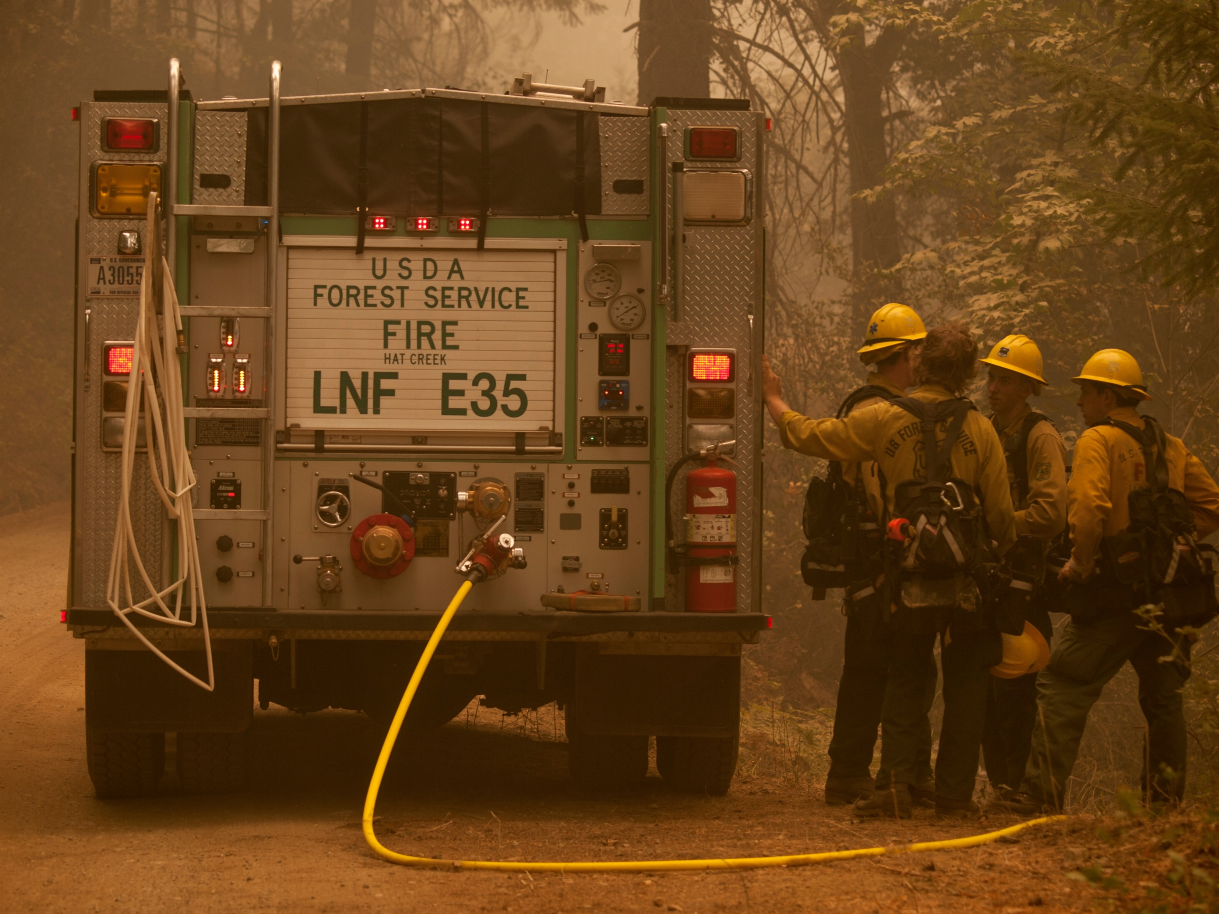
Recommended Responder Actions: Operations
Don high visibility apparel prior to exiting the emergency vehicle.
Do not exit until instructed.
Exit on the side away from the roadway or where exposure to moving vehicle hazards is minimized.
Implement traffic control measures.
Photo credit: U.S. Forest Service
Notes:
Recommended actions emergency responders can take on the ground to directly address contributing factors by limiting exposure to hazards from moving vehicles include the following:
Don high visibility apparel prior to exiting the emergency vehicle.
Do not exit the emergency vehicle until instructed to do so.
Exit the fire apparatus on the side away from the roadway or where exposure to moving vehicle hazards is minimized.
Implement traffic control measures appropriate to the situation.
Notes:
High visibility apparel should be compliant with the requirements in the Manual on Uniform Traffic Control Devices for Streets and Highways.
Pocket “Cue Cards” for field use in traffic management at wildfires is available in Protecting Emergency Responders from Moving Vehicles During Wildfire Responses Resources & References section, to help guide implementation.
Image: https://www.fs.usda.gov/science-technology/fire

Slide 11
Recommended Responder Actions: Operations
Post a lookout to watch for oncoming traffic.
Follow proper backing up procedures.
Reduce exposure to traffic — terminate emergency responses on roadways as quickly as possible.
Photo credit: U.S. Forest Service
Notes:
Recommended actions emergency responders can take on the ground to directly address contributing factors by limiting exposure to hazards from moving vehicles include the following:
Post a lookout to watch for oncoming traffic.
Follow proper backing up procedures, including using a spotter.
Terminate emergency responses on roadways as quickly as possible to reduce personnel exposure to moving traffic and other hazards.
Notes:
A video of a recommended backing up procedure is available here: https://www.respondersafety.com/training/backing-up-emergency-vehicles/
Pocket “Cue Cards” for field use in traffic management at wildfires is available in Protecting Emergency Responders from Moving Vehicles During Wildfire Responses Resources & References section, to help guide implementation.
Image: https://www.fs.usda.gov/science-technology/fire

Slide 12
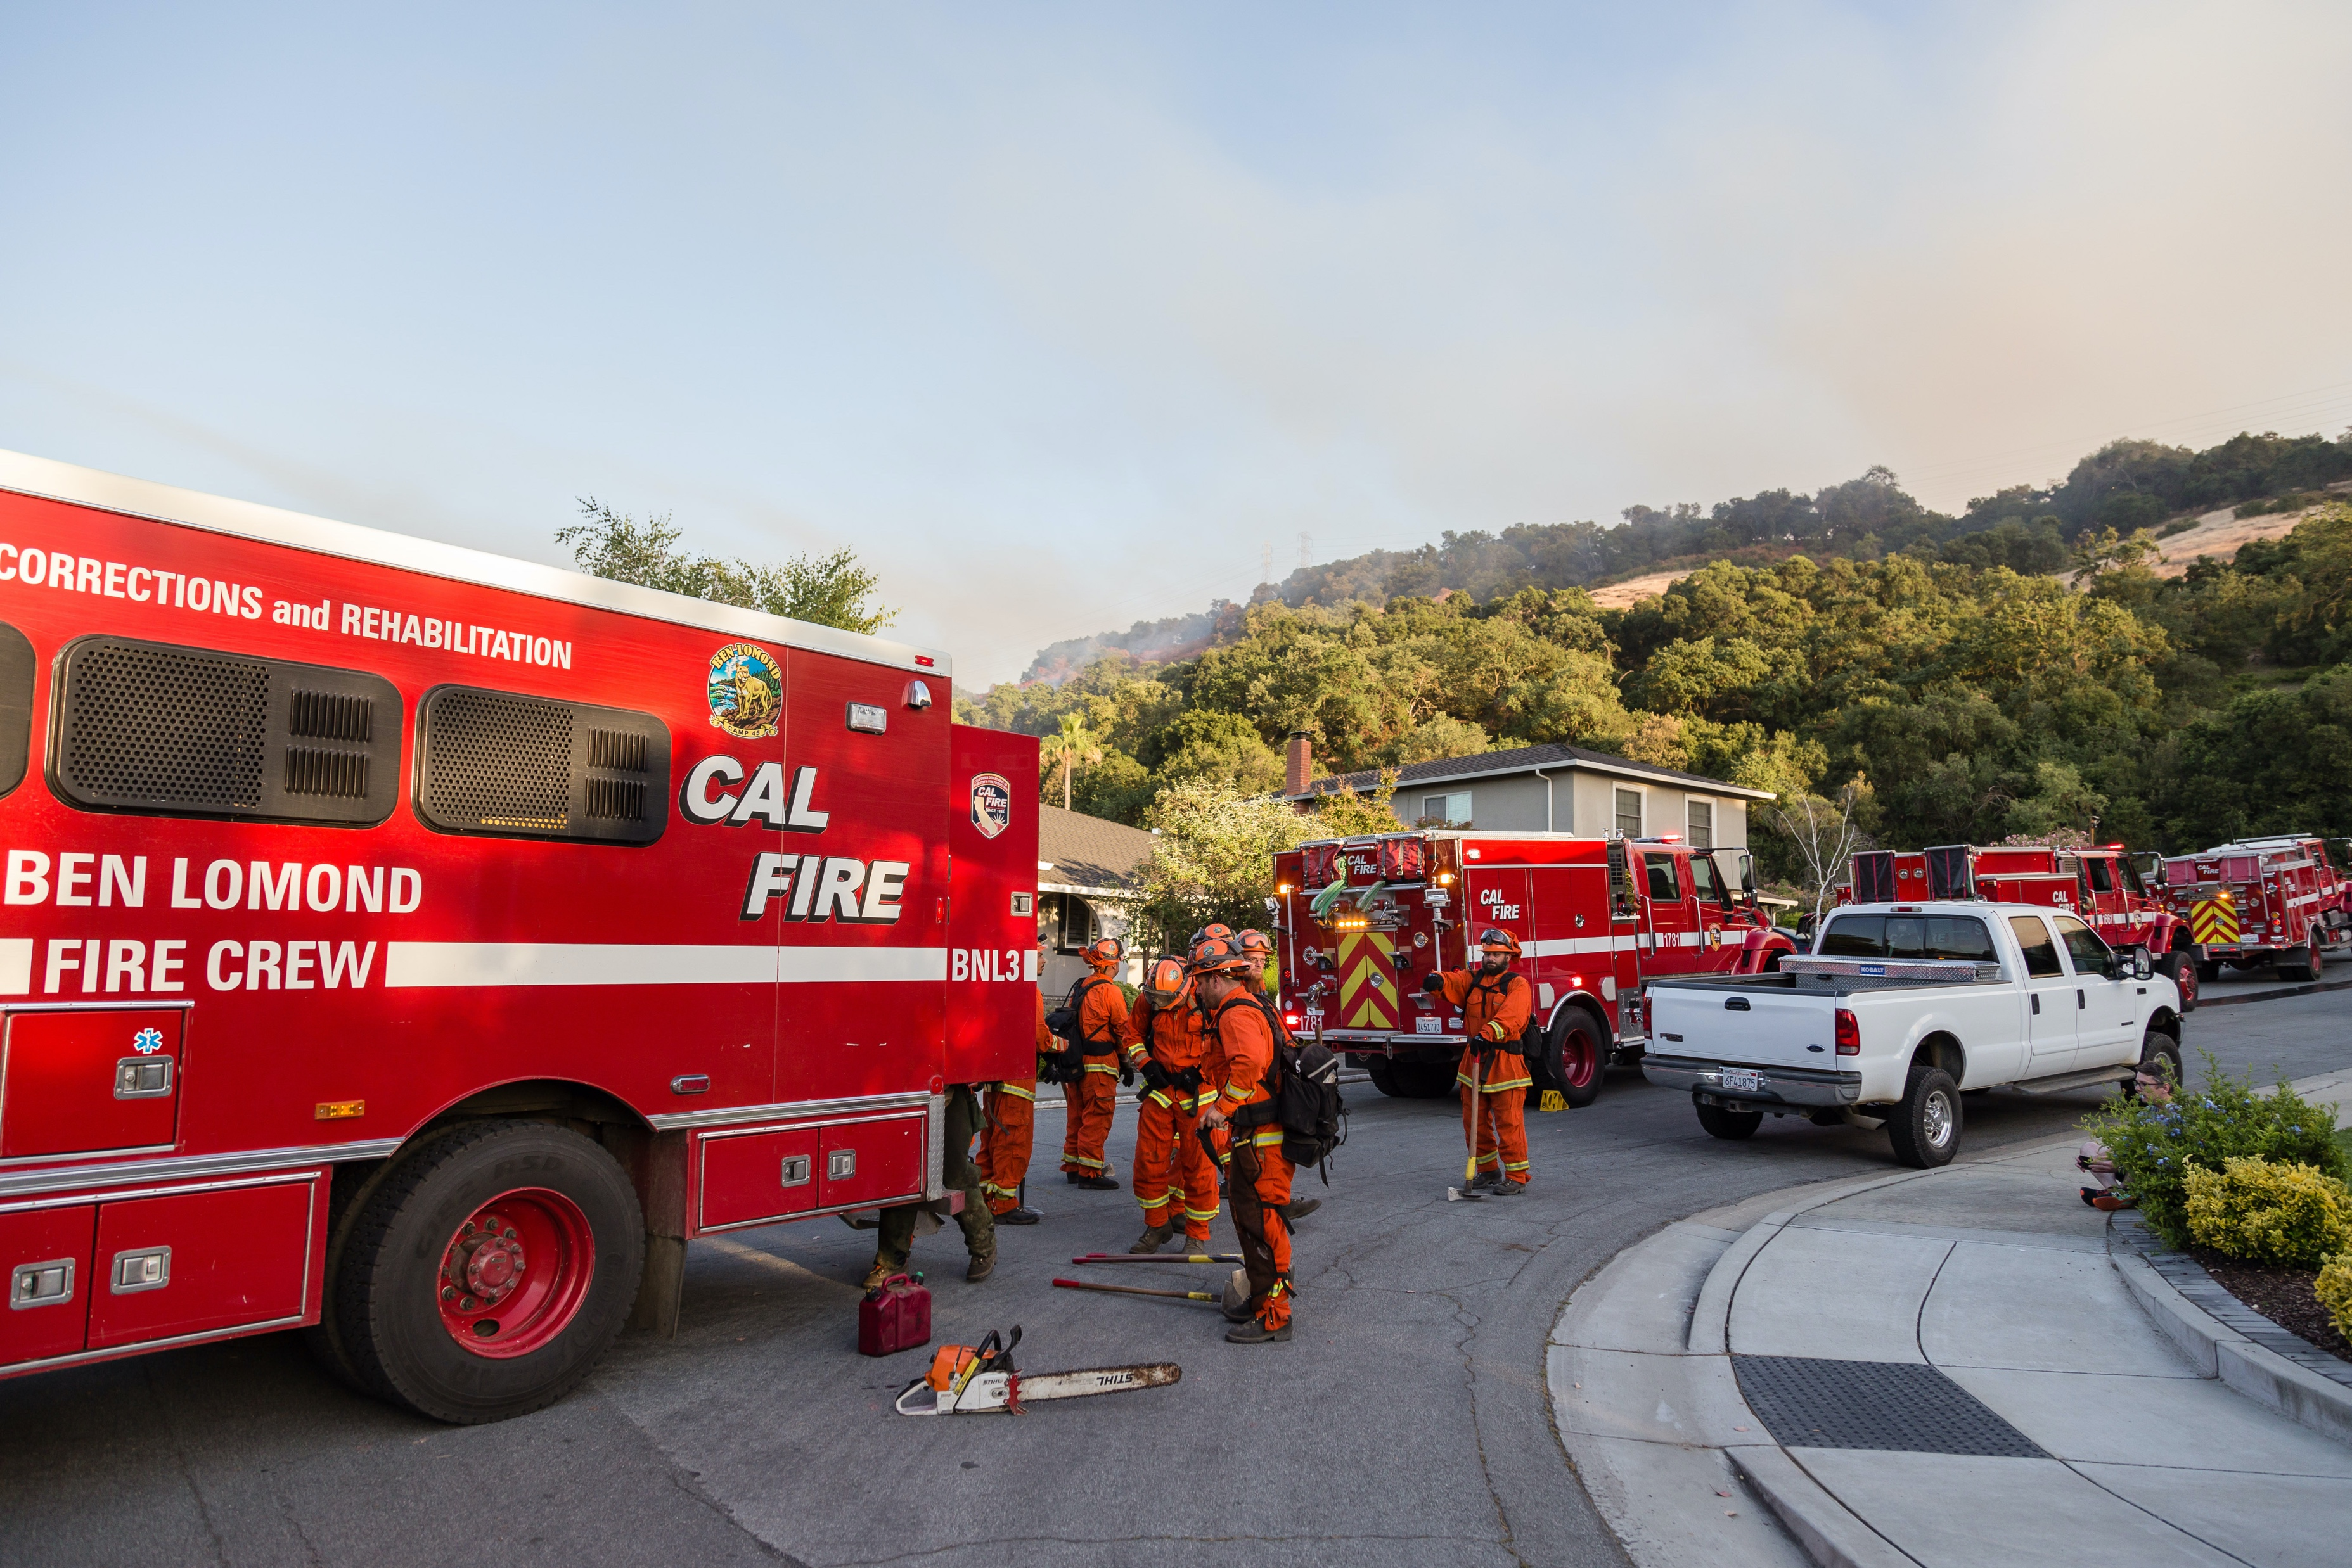
Recommended Responder Actions: Training and Equipment
Craft interagency pre-incident plans that include scene safety and traffic control.
Train on SOGs/SOPs, including TIM.
Instruct driver-operators on apparatus placement for blocking and safe backing.
Equip emergency vehicles with devices to
assist in safe backing up.
Wear appropriate high visibility apparel/PPE
when operating on or near moving vehicles.
  MUTCD-compliant
  OSHA-compliant, if applicable
  NFPA standards-compliant
Notes:
Analyzing the contributing factors showed there are recommended training and equipment actions emergency responders can take to limit exposure to possible incidents, including:
Craft pre-incident plans that include scene safety and traffic control cooperatively across all agencies.
Train on standard operating guidelines and procedures, including deploying temporary traffic control and conducting manual traffic control.
Instruct driver/operators in positioning apparatus to protect emergency responders from oncoming traffic (blocking) and safe backing procedures.
Equip emergency vehicles with devices to assist in safe backing up.
When operating on or near moving vehicles, require wearing high visibility personal protective equipment appropriate to the current task that is compliant with the Manual on Uniform Traffic Control Devices for Streets and Highways (MUTCD), Occupational Safety and Health Administration (OSHA) regulations (if applicable), and National Fire Protection Association (NFPA) standards.

Slide 13
Effective Traffic Management Requires…
Understanding the scene and incident
An awareness of the surroundings
Awareness of pre-plan and response plan details in place
Knowing weather conditions and continually checking the local weather forecast
Situational
Awareness
Is Critical
To Safe Operations
Notes:
Effectively performing traffic management duties at wildfire responses has several dimensions, including:
Understanding the scene and incident
An awareness of the surroundings, including topography, location of area roads (including slopes), and vegetation conditions and fuel class.
Awareness of pre-plan and response plan details in place.
Knowing weather conditions and continually checking the local weather forecast, paying particular attention to issues relevant to the local area, such as the Low Visibility Occurrence Risk Index (LVORI), which contributes to super fog.
These are all aspects of situational awareness. Each responder and each officer is responsible for personnel and civilian safety and should constantly monitor the situation and be aware of anything that might adversely affect operational safety. Communicate hazards immediately, revising practices as appropriate.

Slide 14
Effective Traffic Management Requires…
Knowing the capabilities of the personnel on scene
Knowing the traffic control devices available and how to best deploy them
Assigning trained and qualified personnel to set up and maintain temporary traffic control devices
Situational
Awareness
Is Critical
To Safe Operations
Notes:
Effectively performing traffic management duties at wildfire responses has several dimensions, including:
Knowing the capabilities of the personnel on scene, particularly for officers and supervisors tasked with emergency responder safety.
Knowing the traffic control devices available and how to best deploy them.
Assigning trained and qualified personnel to set up and maintain temporary traffic control devices.
These are all aspects of situational awareness. Each responder and each officer is responsible for personnel and civilian safety and should constantly monitor the situation and be aware of anything that might adversely affect operational safety. Communicate hazards immediately, revising practices as appropriate.

Slide 15
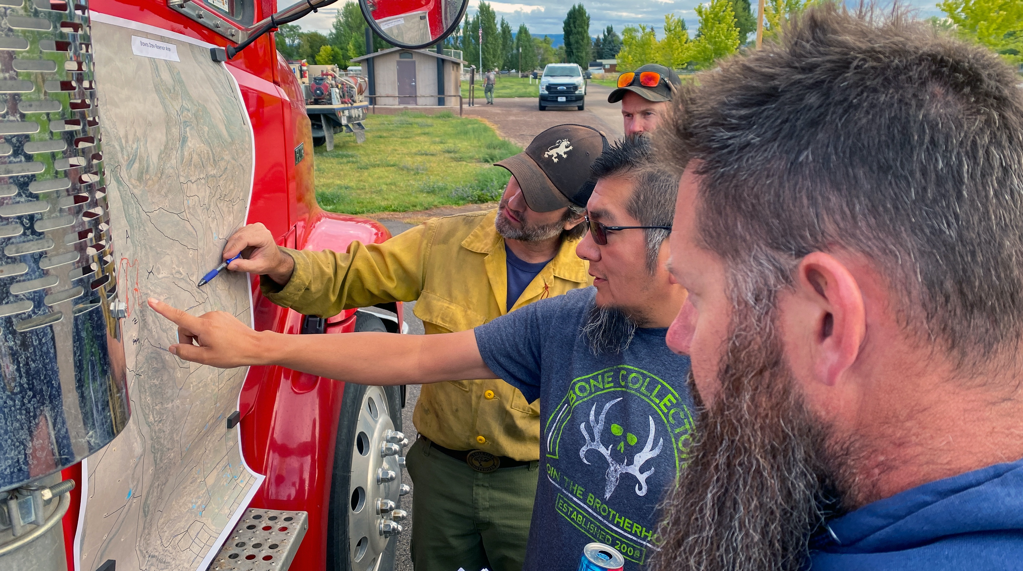
Incident Command
Sizing up the situation
Analyzing how the wildland fire might impact nearby roadways
Determining which traffic control measures are necessary
Directing the trained and qualified personnel to implement those measures
Photo credit: National Interagency Fire Center
Notes:
Positive response outcomes start with and end with strong incident command. Command is responsible for:
Sizing up the situation.
Analyzing how the wildland fire might impact nearby roadways.
Determining which traffic control measures are necessary on each of those roadways given those potential impacts and associated hazards.
the trained and qualified personnel to implement those measures.
The incident commander integrates these concerns into applying appropriate traffic control practices for safe operations.

Slide 16
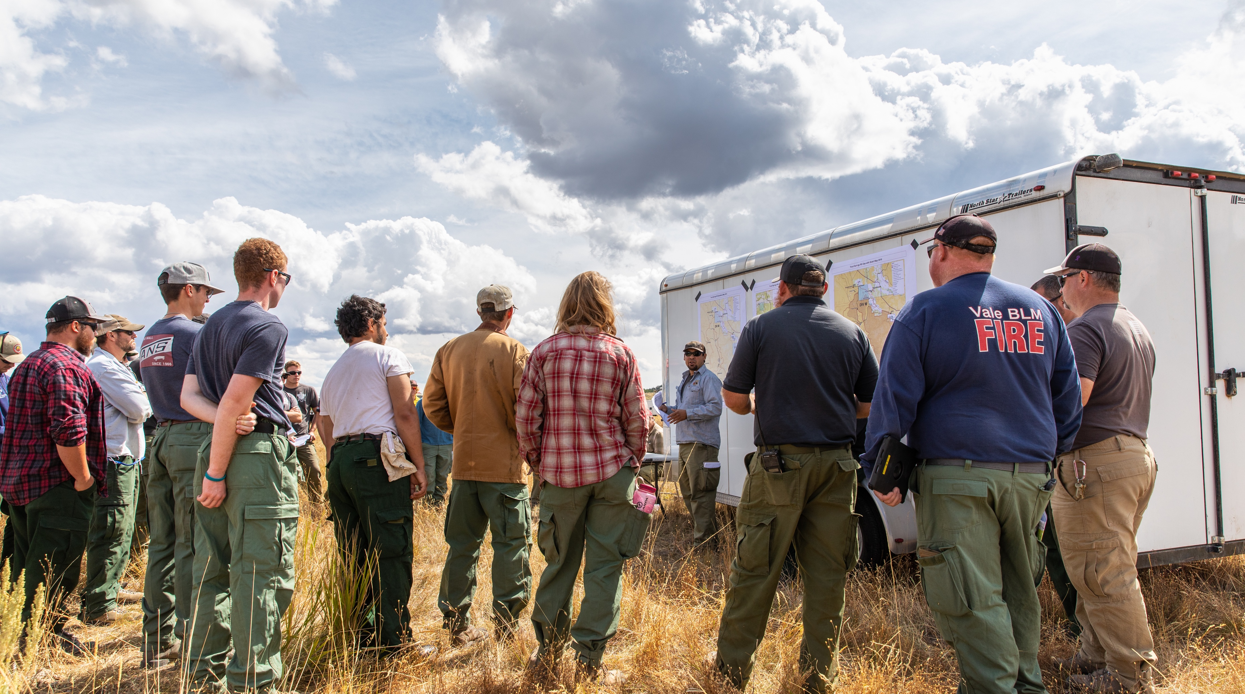
Incident Command
Requiring SOPs to be followed
Monitoring the traffic incident management area setup
Assessing hazards of moving vehicles off-road in the back country and implementing appropriate vehicle movement safety procedures
Photo credit: National Interagency Fire Center
Notes:
Positive response outcomes start with and end with strong incident command. Command is responsible for:
Requiring SOPs to be followed.
Monitoring the traffic incident management area setup as the incident evolves and directing changes to traffic control as the situation changes.
Assessing hazards of moving vehicles off-road in the back country and implementing appropriate vehicle movement safety procedures, including banning exterior riding, requiring a spotter when backing up, and cordoning off encampments.
The incident commander integrates these concerns into applying appropriate traffic control practices for safe operations.

Slide 17
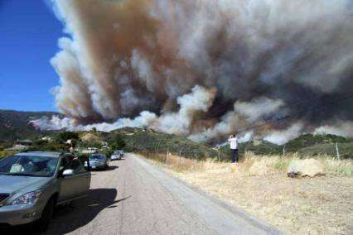
Basic Traffic Control Practices for Safe Operations
Pre-planning
Advanced warning
Visibility
Blocking
Safe backing of emergency vehicles
Personal protective equipment
Evacuation
Photo credit: U.S. Forest Service
Notes:
Emergency service organizations (ESO) respond to a wide variety of incidents involving operations on or near a roadway. Wildfires are just one type of these incidents but pose unique challenges. Operations at wildfires pose special risks to personnel performing fire, rescue, and EMS functions.
In many instances, an ESO responds to a “primary incident” along a roadway, only to become the victim of a “secondary incident”: the nightmare in which a firefighter, EMS provider, police officer, or other responder is suddenly struck and killed by a vehicle while operating at the primary incident. No one individual or group can control drivers of other vehicles, but there are fundamental steps an organization can take to improve the level of safety at primary incidents to decrease the chance of a secondary crash. These same basic TIM practices contribute to safe, efficient operations at wildfires:
Pre-planning
Advance warning
Visibility
Blocking
Safe backing of emergency vehicles
Personal protective equipment
Evacuation
Note: Blocking uses a fire apparatus or other large vehicle to physically protect an emergency scene by providing a safe area for incident operations.
Let’s take a look at each.

